Slide 1
EDM and the 4th Paradigm of Scientific Discovery Reflections On The 2010 KDD Cup Competition
John Stamper
Human-Computer Interaction Institute
Carnegie Mellon University
Technical Director
Pittsburgh Science of Learning Center DataShop

Slide 2
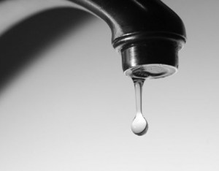

Slide 3
eScience
Jim Gray – the 4th paradigm

Slide 4
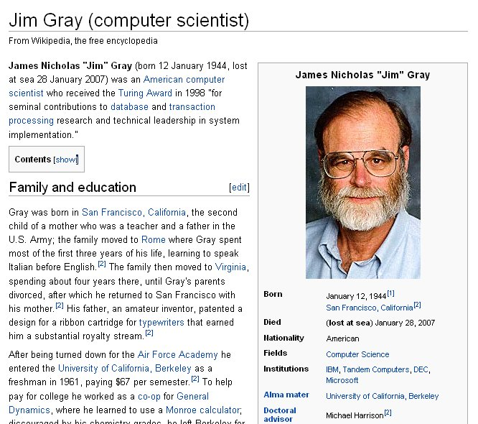
http://en.wikipedia.org/wiki/Jim_Gray_(computer_scientist)

Slide 5
Paradigms of Scientific Exploration
Empirical – started thousands of years ago
Theoretical – last few hundred years
Computational – last 30 – 40 years
Data Exploration (eScience)

Slide 6

The Book
http://www.fourthparadigm.com

Slide 7
Data Exploration
Driven by the availability (or overabundance) of data
Ties simulation with data analysis, highly statistical
Requires tools to collect, analyze, and visualize large data sets

Slide 8
Data Exploration
Focus Areas
Health (Medicine, DNA)
Environmental (Global Warming)
Astronomy (Galaxy Mapping)
Physics (CERN)
Education is missing
http://www.fourthparadigm.com

Slide 9
Can EDM be part of eScience?
We need:
Data
Tools
Ideas and methods

Slide 10
EDM Data Size
What is the right size for EDM discovery?

Slide 11
Data Granularity
Finest – Transaction
Steps
Problems
Units
Tests
Class Grades
Class Avgs
Schools
Coarsest - ….
We are mostly here
Policy is being made here

Slide 12
EDM Conference Data
2010
Average 520 Students
Median 148 Students
Largest 172,000 Transactions
2009
Average 1,168 Students
Median 300 Students
Largest 437,000 Transactions

Slide 13
How about 2011?
Hypothesis – Average will be larger due mainly to a few large datasets

Slide 14
Trend towards larger data sets…
… and they are coming!
Carnegie Learning / Assistments
Seeing a move from collecting data to secondary analysis
This is good, but it has risks!

Slide 15
Risks of Secondary Analysis
Misunderstanding the data
Stagnation on a few datasets
Privacy/Security

Slide 16
Minimizing the risks
Misunderstanding the data – Standard formats
Stagnation on a few datasets – turn on the flow
Privacy/Security – must have reasonable procedures to protect student identity
Warning – Shameless Plug Ahead!!!

Slide 17
Standard Repositories
Repositories like DataShop are one way to mitigate these issues and provide:
Standardization
Privacy/Security
Lots of data

Slide 18
DataShop Stats…

Slide 19
DataShop - How to increase awareness?
Tutorials/Workshops
Press/media
Competitions

Slide 20
2010 KDD Cup Competition
KDD Cup is the premier data mining challenge
2010 KDD Cup called “Educational Data Mining Challenge”
Ran from April 2010 through June 2010

Slide 21



2010 KDD Cup Competition
The challenge asked participants to predict student performance on mathematical problems from logs of student interaction with Intelligent Tutoring Systems.

Slide 22
KDD Cup Competition
Why do we care?
Advances in prediction
Advances modeling

Slide 23
Prediction
Prediction of student performance is the reason for assessment.
Tons of effort placed on Standardized Testing
What if we could predict from student data better?
Feng, M., Heffernan, N.T., & Koedinger, K.R. (2009). Addressing the assessment challenge in an online system that tutors as it assesses. User Modeling and User-Adapted Interaction: The Journal of Personalization Research (UMUAI). 19(3), pp. 243-266.

Slide 24
Modeling
Student Models drive many of the decisions for adaptive instruction
What level of granularity should these models be?
Better Student Models should lead to faster learning

Slide 25
The Data
Data was provided by Carnegie Learning Inc
Dataset | Students | Steps | File size
Algebra I 2008-2009 | 3,310 | 9,426,966 | 3 GB
Bridge to Algebra 2008-2009 | 6,043 | 20,768,884 | 5.43 GB

Slide 26
Details on the Data
Row | Student | Problem | Step | Incorrects | Hints | Error Rate | Knowledge component | Opportunity Count
1 | S01 | WATERING_VEGGIES | (WATERED-AREA Q1) | 0 | 0 | 0 | Circle-Area | 1
2 | S01 | WATERING_VEGGIES | (TOTAL-GARDEN Q1) | 2 | 1 | 1 | Rectangle-Area | 1
3 | S01 | WATERING_VEGGIES | (UNWATERED-AREA Q1) | 0 | 0 | 0 | Compose-Areas | 1
4 | S01 | WATERING_VEGGIES | DONE | 0 | 0 | 0 | Determine-Done | 1
5 | S01 | MAKING-CANS | (POG-RADIUS Q1) | 0 | 0 | 0 | Enter-Given | 1
6 | S01 | MAKING-CANS | (SQUARE-BASE Q1) | 0 | 0 | 0 | Enter-Given | 2
7 | S01 | MAKING-CANS | (SQUARE-AREA Q1) | 0 | 0 | 0 | Square-Area | 1
8 | S01 | MAKING-CANS | (POG-AREA Q1) | 0 | 0 | 0 | Circle-Area | 2
9 | S01 | MAKING-CANS | (SCRAP-METAL-AREA Q1) | 2 | 0 | 1 | Compose-Areas | 2
10 | S01 | MAKING-CANS | (POG-RADIUS Q2) | 0 | 0 | 0 | Enter-Given | 3

Slide 27
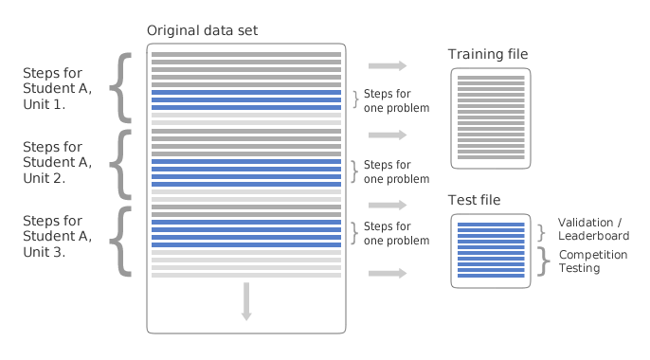
Details on the Data
Splitting Data for the Competition

Slide 28
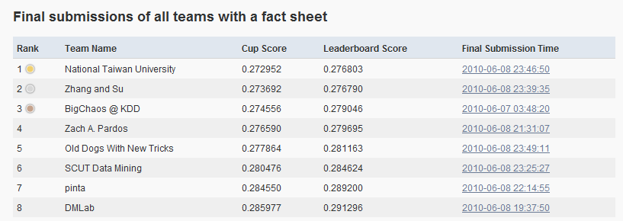
2010 KDD Cup Competition
655 registered participants
130 participants who submitted predictions
3,400 submissions

Slide 29
Solutions 1st National Taiwan University
Used a DM course around 2010 KDD CUP
Expanded features by various binarization and discretization techniques
Resulting sparse feature sets are trained by logistic regression (using LIBLINEAR)
Condensed features so that the number is less than 20.
Final submission used ensemble by linear regression.

Slide 30
Solutions 2nd Zhang and Su
Used combination of techniques
Gradient Boosting Machines
Singular Value Decomposition
Combined results of multiple SVDs which is called Gradient Boosting.

Slide 31
Solutions 3rd Big Chaos @ KDD
Used collaborative filtering techniques
Matrix Factorization
Factorize student/step/group relationships
Other Baseline Predictions
Neural network combines an ensemble of predictions
Originally developed for the Netflix competition

Slide 32
Solutions 4th Zach Pardos
Used a novel Bayesian HMM
learns individualized student specific parameters (prior, learn rate, guess and slip)
uses these parameters to train skill specific models.
The bagged decision tree classifier was the primary classifier
Bayesian model was used in ensemble selection to generate extra features for decision tree classifier

Slide 33
What did we learn?
The top teams used very different techniques to achieve similar results
More work still needed to bring these techniques into the mainstream
How good does the prediction have to be?

Slide 34
2010 KDD Cup Benefits
Advances in prediction and student modeling
Excitement in the KDD Community
The datasets are now in the “wild” and showing up in non KDD conferences
Competition site is still up and functioning! (including facts and papers from winning teams!)

Slide 35
2010 KDD Cup Competition
Next steps to continue momentum?

Slide 36
2012 EDM Cup Competition!
Goals
Generate Excitement within the EDM Community
Use as a bridge to connect KDD, LAKS, EC-TEL, AERA, etc.
Make the competition annual
Have each year build on knowledge gained from previous year
Vary the questions and data

Slide 37
The Future of EDM
More and more data will come
It needs to be mined
EDM as a community or conference?

Slide 38
EDM Data Size
What is the right size for EDM Discovery?

Slide 39
PSLC DataShop a data analysis service for the learning science community
Free Data is there,
Use it!
Make Discoveries!
http://pslcdatashop.org

