Slide 1
DataShop v7.1 Release Event
http://pslcdatashop.org
Friday, November 1, 2013
LearnLab DataShop
datashop-help@lists.andrew.cmu.edu
LearnLabdatashop.org

Slide 2
Agenda
Introduction
What can I do?
Learning curve categorization
Import datasets yourself
Custom fields
Hands on
LearnLab DataShop
datashop-help@lists.andrew.cmu.edu
pslcdatashop.org

Slide 3
THE Datashop team
John Stamper - DataShop Technical Director
Alida Skogsholm - DataShop Manager, Developer
Brett Leber - Interaction Designer
Mike Komisin - DataShop Developer
Cindy Tipper - DataShop Developer
Sandy Demi - Quality Assurance and Testing
Ken Koedinger – LearnLab Director
Jo Bodnar – LearnLab Admin
LearnLab DataShop
datashop-help@lists.andrew.cmu.edu
pslcdatashop.org

Slide 4
What is DataShop?
Central Repository
Secure place to store & access research data
Supports various kinds of research
Analysis & Reporting Tools
Focus on student-tutor interaction data
Learning curves & error reports provide summary and low-level views of student performance
Performance Profiler aggregates across various levels of granularity (problem, dataset levels, knowledge components, etc.)
Data Export
New tools created to meet highest demands

Slide 5
Repository
Allows for full data management
Controlled access for collaboration
File attachments
Paper attachments
Great for secondary analyses

Slide 6
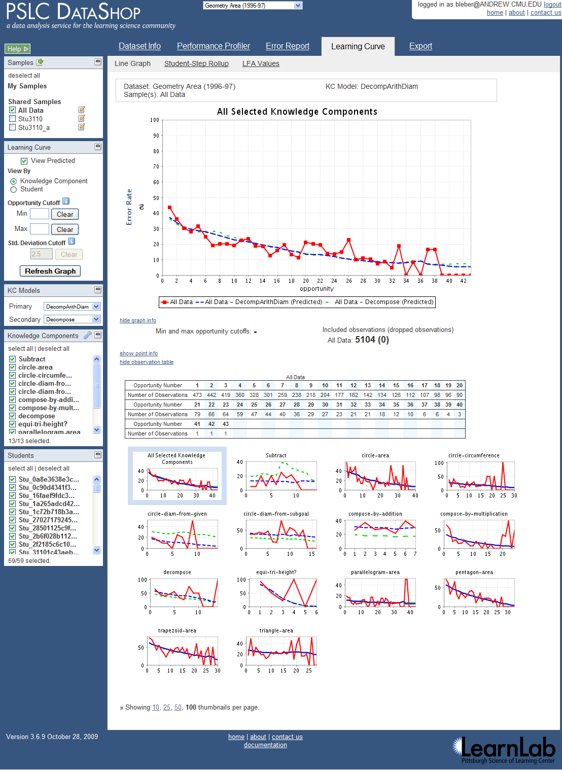
Web application
Knowledge component model analysis with learning curves
Learning curve point decomposition

Slide 7
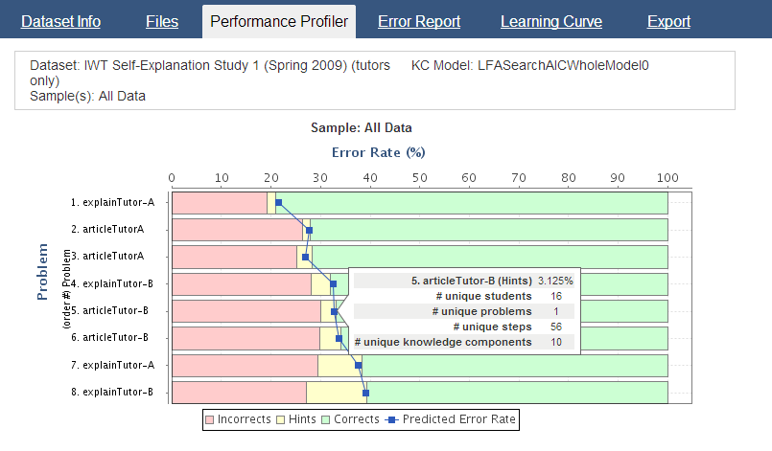
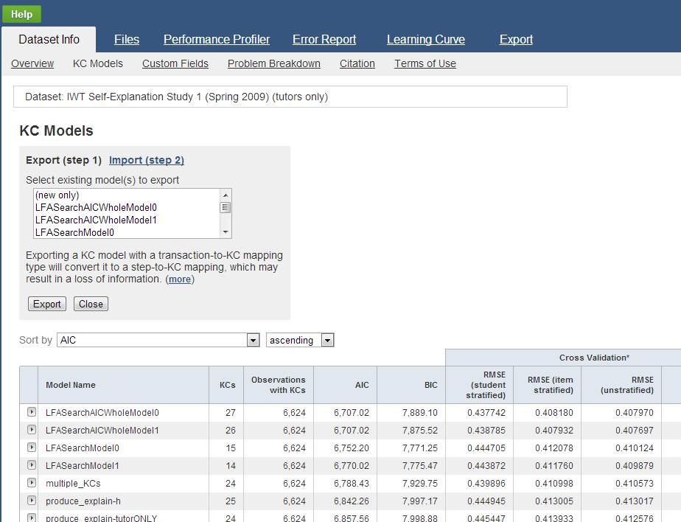
Web application
Performance Profiler tool for exploring the data
Easy knowledge component model creation

Slide 8
DataShop Terminology
Problem: a task for a student to perform that typically involves multiple steps
Step: an observable part of the solution to a problem
Transaction: an interaction between the student and the tutoring system.
LearnLab DataShop
datashop-help@lists.andrew.cmu.edu
pslcdatashop.org

Slide 9
DataShop Terminology
KC: Knowledge component
also known as a skill/concept/fact
a piece of information that can be used to accomplish tasks
KC Model:
also known as a cognitive model or skill model
a mapping between correct steps and knowledge components
LearnLab DataShop
datashop-help@lists.andrew.cmu.edu
pslcdatashop.org

Slide 10
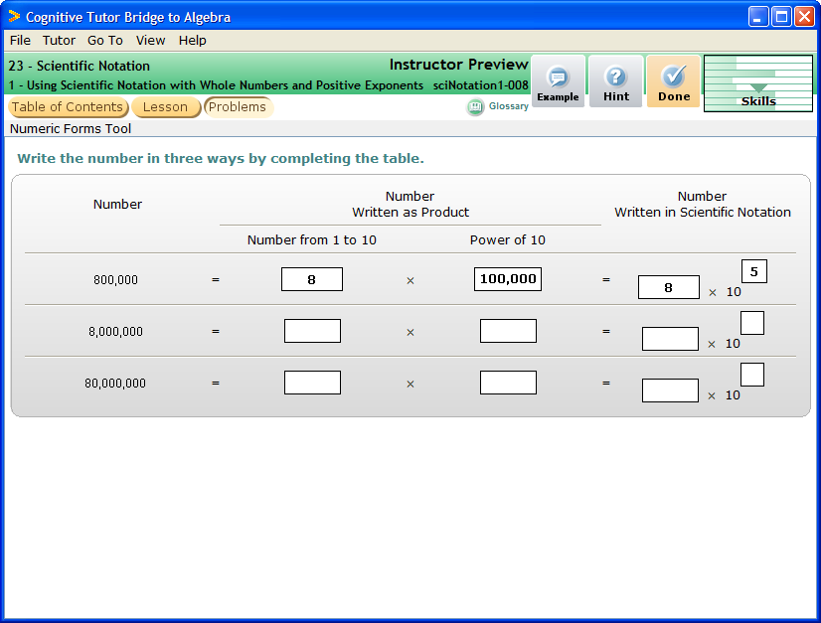
Base1 | 6
Base2
Base3
ExpandedPower1 | 100,000,000
ExpandedPower2
ExpandedPower3
Exponent1 | 8
Exponent2
Exponent3
GeneralHelpGoalNode
Multiplier1 | 6
Multiplier2
Multiplier3
Notes:
Complete UI

Slide 11
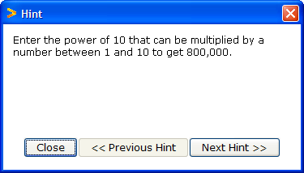
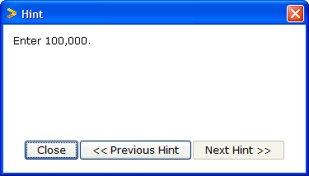
Multiplier
ExpandedPower
Base
Exponent
6
8
100,000
5
10,000
8
Exponent1
Multiplier1
ExpandedPower1
Base1
Multiplier2
ExpandedPower2
Base2
Exponent2
Multiplier3
ExpandedPower3
Base3
Exponent3
Transactions
Student-Steps
Enter 8 in Multiplier1
Multiplier1
Observation
Ask for hint on next step
Enter 10,000 in ExpandedPower1
ExpandedPower1
Ask for hint
Enter 100,000 in ExpandedPower1
Enter 8 in Base1
Base1
Observation
Enter 6 in Exponent1
Exponent1
Enter 5 in Exponent1
Notes:
English version. When a transaction appears, it’s an attempt. When the group of transactions appears, this is toward a step. The group is considered an “observation”.

Slide 12
Multiplier
ExpandedPower
Base
Exponent
6
8
100,000
5
10,000
8
Exponent1
Multiplier1
ExpandedPower1
Base1
Multiplier2
ExpandedPower2
Base2
Exponent2
Multiplier3
ExpandedPower3
Base3
Exponent3
Transactions
Student-Steps
Selection Action Input
Step
KC
Opportunity
Multiplier1 UpdateTextField 8
Multiplier1 Multiplier 1
HintButton ButtonPressed HintRequest
ExpandedPower1 UpdateTextField 10,000
ExpandedPower1 Exp.Power 1
HintButton ButtonPressed HintRequest
ExpandedPower1 UpdateTextField 100,000
Base1 UpdateTextField 8
Base1 Base 1
Exponent 1 UpdateTextField 6
Exponent1 UpdateTextField 5
Exponent1 Exponent 1
Notes:
More complex table version—SAI shown, KCs and Opportunities shown

Slide 13

Multiplier
ExpandedPower
Base
Exponent
Multiplier1
ExpandedPower1
Base1
Exponent1
8
100,000
6
Multiplier2
1,000,000
8
Exponent2
ExpandedPower2
Base2
Multiplier3
ExpandedPower3
Base3
Exponent3
Transactions
Student-Steps
Opportunity
Selection Action Input
Student Step
KC
Multiplier2 UpdateTextField 8
S1 Multiplier1 Multiplier 1
ExpandedPower2 UpdateTextField 100,000
S1 ExpandedPower1 Exp.Power 1
ExpandedPower2 UpdateTextField 1,000,000
S1 Base1 Base 1
Base2 UpdateTextField 8
S1 Exponent1 Exponent 1
Exponent 2 UpdateTextField 6
S1 Multiplier2 Multiplier 2
S1 ExpandedPower2 Exp.Power 2
S1 Base2 Base 2
S1 Exponent2 Exponent 2
Notes:
Continuing into row 2 of the problem, where we see opportunity counts increase.

Slide 14
Terminology Review
Observation: a group of transactions for a particular student working on a particular step.
Attempt: transaction; an attempt toward a step
Opportunity: a chance for a student to demonstrate whether he or she has learned a given knowledge component. An opportunity exists each time a step is present with the associated knowledge component.
LearnLab DataShop
datashop-help@lists.andrew.cmu.edu
pslcdatashop.org
Notes:
If one transaction, it’s still an observation.

Slide 15
How do I get data in?
Directly
Some tutors are logging directly to the LearnLab logging database
CTAT-based tutors (when configured correctly)
Indirectly
Other tutors are logging to their own file formats or their own databases
These data require a conversion process
Many studies are in this category

Slide 16
DataShop tools
Koedinger, K.R., Baker, R.S.J.d., Cunningham, K., Skogsholm, A., Leber, B., Stamper, J. (2010) A Data Repository for the EDM commuity: The PSLC DataShop. To appear in Romero, C., Ventura, S., Pechenizkiy, M., Baker, R.S.J.d. (Eds.) Handbook of Educational Data Mining. Boca Raton, FL: CRC Press.
An overview
LearnLab DataShop
datashop-help@lists.andrew.cmu.edu
pslcdatashop.org

Slide 17
Analysis tools
Dataset Info
Performance Profiler
Error Report
Learning Curve
KC Model Export/Import

Slide 18
Getting to DataShop
Explore data through the DataShop tools
Where is DataShop?
http://pslcdatashop.org
Linked from DataShop homepage and learnlab.org
http://pslcdatashop.web.cmu.edu/about/
http://learnlab.org/technologies/datashop/index.php

Slide 19
Creating an account
On DataShop's home page, click “Create an account”. Complete the form to create your DataShop account.
If you’re a CMU student/staff/faculty, click “Log in with WebISO” to create your account.

Slide 20
Getting access to datasets
By default, you will have access to the public datasets.
Of these, we recommend three for getting started:
Digital Games for Improving Number Sense - Study 1
Geometry Area (1996-1997)
Intelligent Writing Tutor (IWT) Self-Explanation Study 1 (Spring 2009)

Slide 21
Getting access to datasets
Your can also request access to other datasets from within DataShop
The PI and Data Provider must approve.
Access is granted at the project level

Slide 22
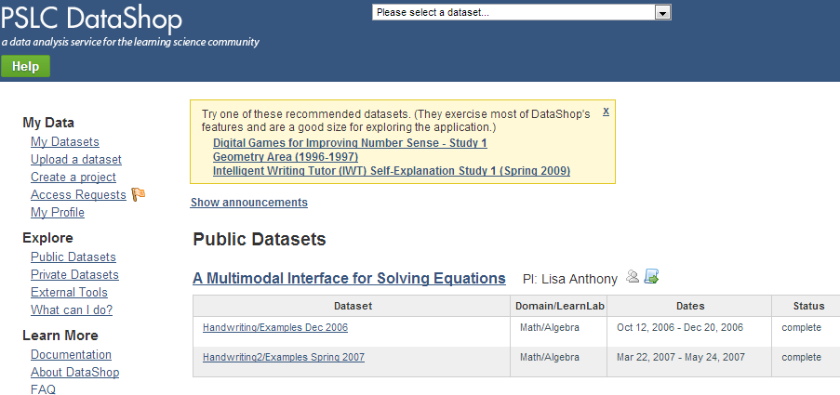
Dataset selection
Datasets you can view or edit. You have to be a project member or PI for the dataset to appear here.
Public datasets that you can view only.
Private datasets you can’t view. Email us and the PI to get access.

Slide 23
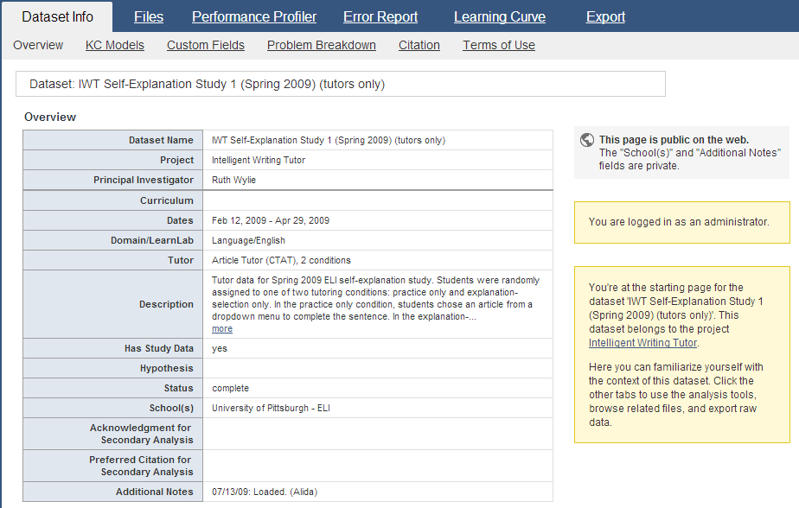
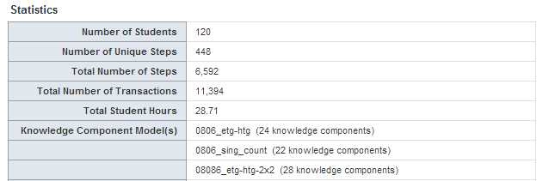
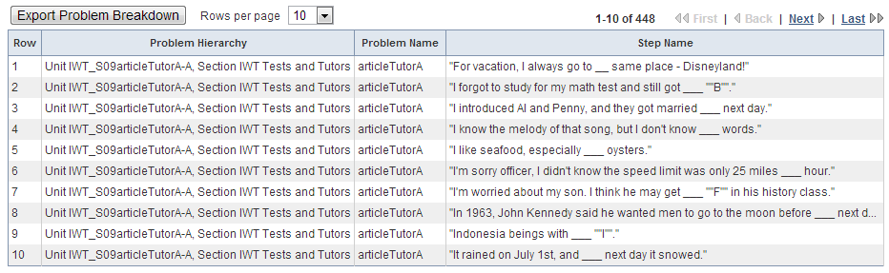
Dataset INfo
Papers and files storage
Meta data for given dataset
PI’s get ‘edit’ privilege, others must request it
Dataset Metrics
Problem Breakdown table

Slide 24
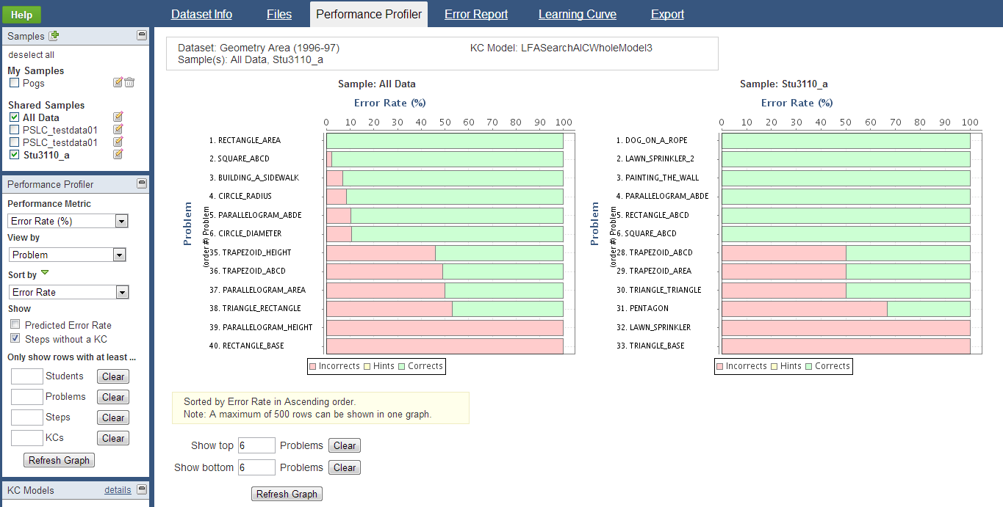
Performance Profiler
Multipurpose tool to help identify areas that are too hard or easy
View measures of
Error Rate
Assistance Score
Avg # Hints
Avg # Incorrect
Residual Error Rate
View multiple samples side by side
Aggregate by
Step
Problem
Student
KC
Dataset Level
Mouse over a row to reveal uniqueness

Slide 25
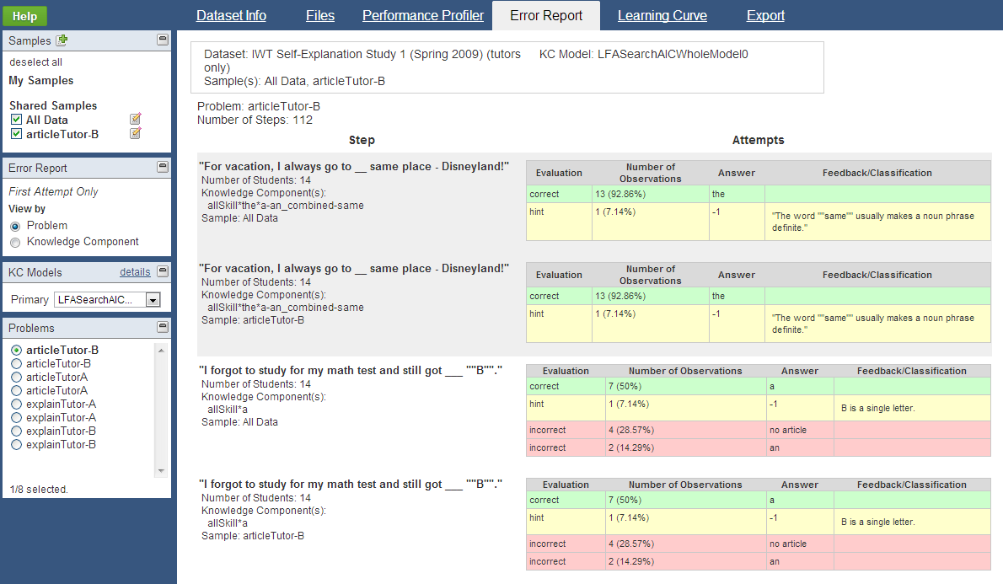
Error Report
Provides a breakdown of problem information (by step) for fine-grained analysis of problem-solving behavior
Attempts are categorized by evaluation
View by Problem or KC

Slide 26
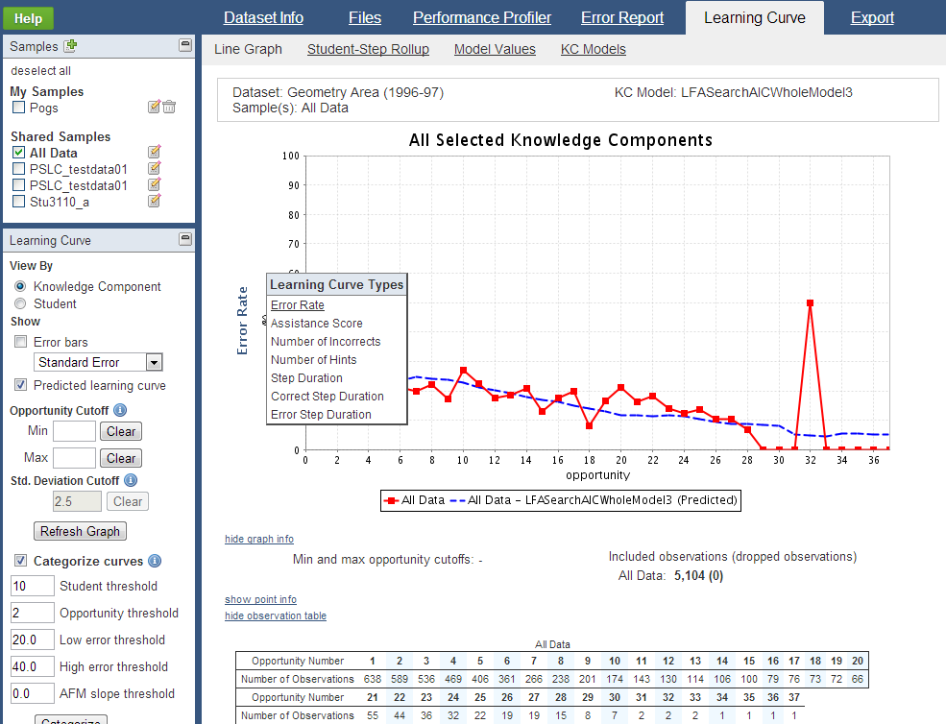
Learning curves
Visualizes changes in student performance over time
Hover the y-axis to change the type of Learning Curve.
Types include:
Error Rate
Assistance Score
Number of Incorrects
Number of Hints
Step Duration
Correct Step Duration
Error Step Duration
Time is represented on the x-axis as ‘opportunity’, or the # of times a student (or students) had an opportunity to demonstrate a KC

Slide 27
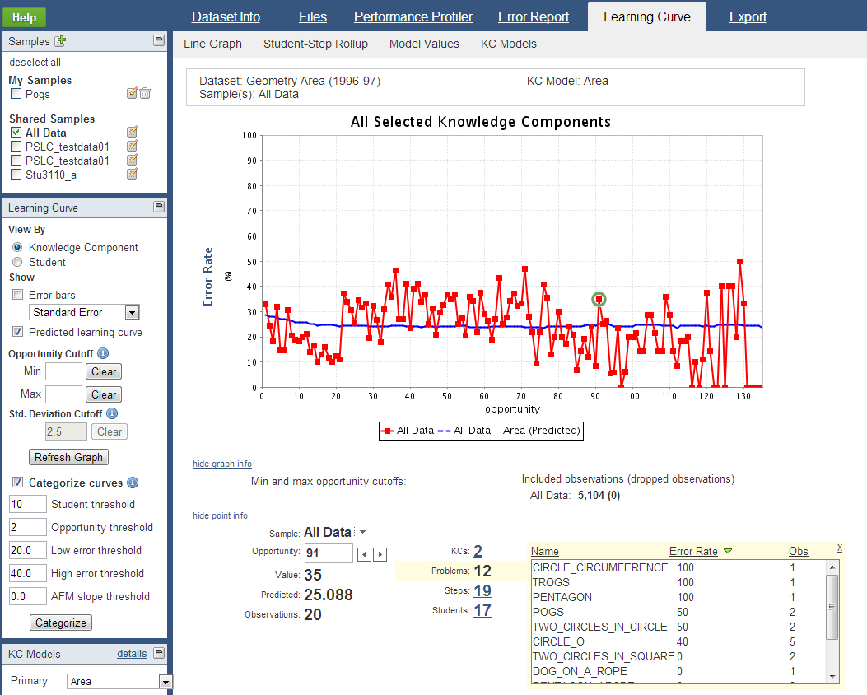
Learning curves: Drill down
Click on a data point to view point information
Click on the number link to view details of a particular drill down information.
Details include:
Name
Value
Number of Observations
Four types of information for a data point:
KCs
Problems
Steps
Students

Slide 28
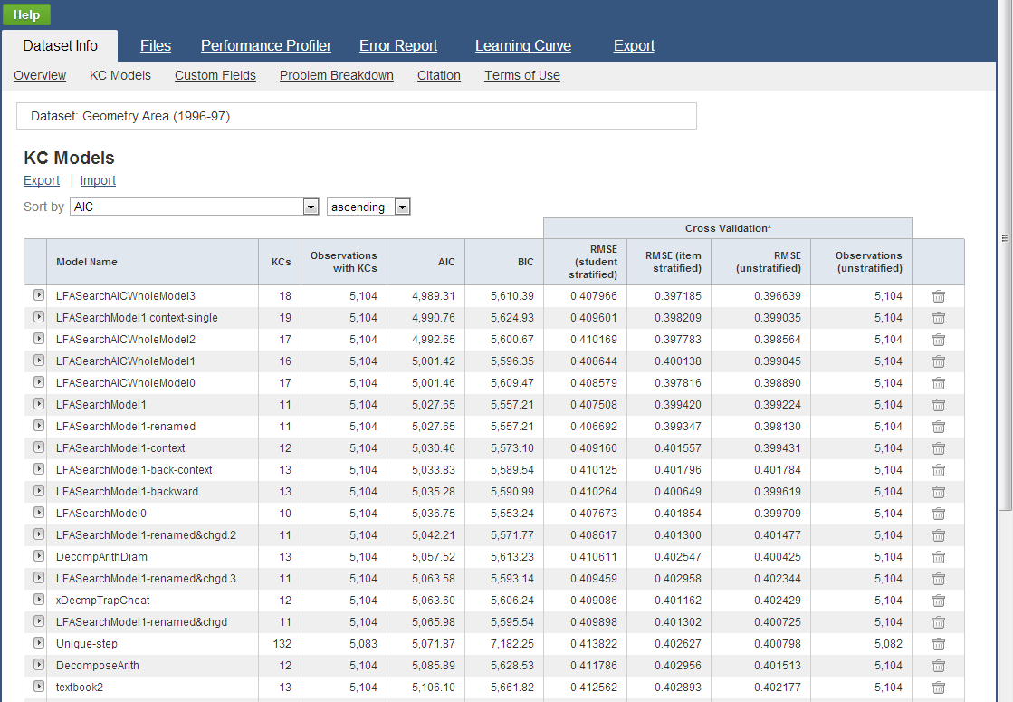
Knowledge component models
Import/Export new or updated KC Models here

Slide 29
Web services
To access the data from a program
New visualization tools
Data mining
or other application

Slide 30
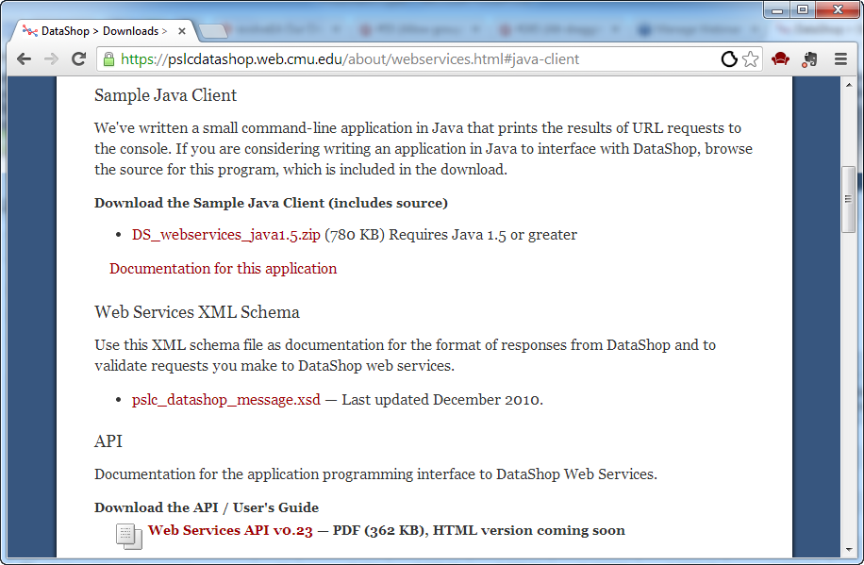
Get web services download

Slide 31
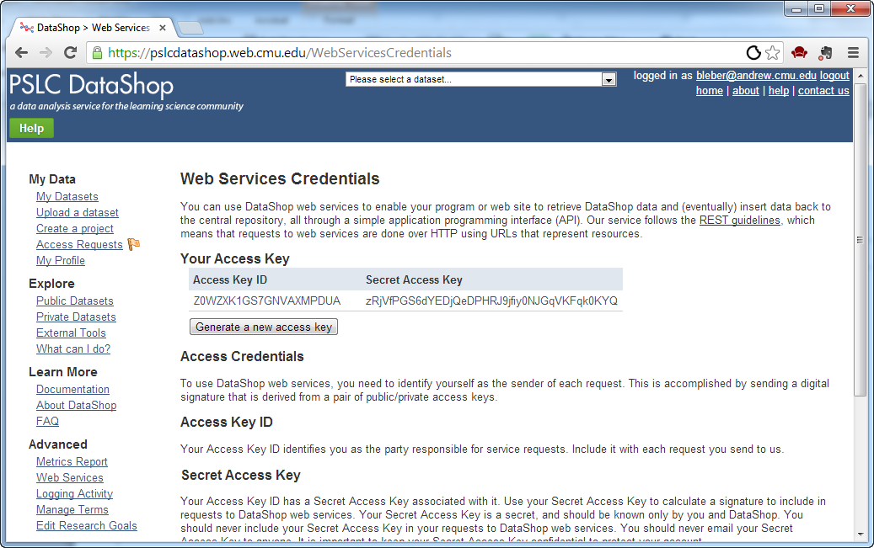
Getting credentials

Slide 32
To get more details …
http://pslcdatashop.org/about/webservices.html
http://pslcdatashop.org/downloads/ WebServicesDemoClient_src.zip

Slide 33
KDD Cup 2010 EDM Challenge
http://pslcdatashop.org/KDDCup
Awarded to the PSLC and DataShop
First time the challenge used education data
Challenge asked participants to predict student performance on mathematical problems from logs of student interaction with Intelligent Tutoring Systems.
The competition addressed questions of both scientific and practical importance.
Improved models could be saving millions of hours of students' time (and effort) in learning algebra.
These models should both increase achievement levels and reduce time needed to learn.

Slide 34
The datasets used for the challenge were:
Dataset | Students | Steps | File size
Algebra I 2008-2009 | 3,310 | 9,426,966 | 3 GB
Bridge to Algebra 2008-2009 | 6,043 | 20,768,884 | 5.43 GB
The competition ended on June 8, 2010. There were:
655 registered teams
130 teams who submitted predictions
3,400 submissions

Slide 35
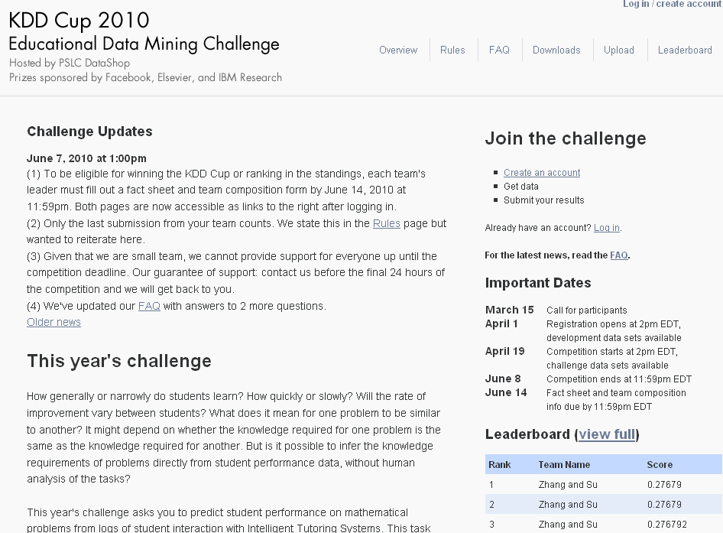

Slide 36
DataShop – what’s in it for me?
Free tools to analyze your data
Free researchers to analyze your data
Real opportunities to validate ideas across multiple data sets

Slide 37
What can I do?
Follow a link to a topic and you'll see a description of how this goal has been achieved with DataShop data.
LearnLab DataShop
datashop-help@lists.andrew.cmu.edu
pslcdatashop.org

Slide 38
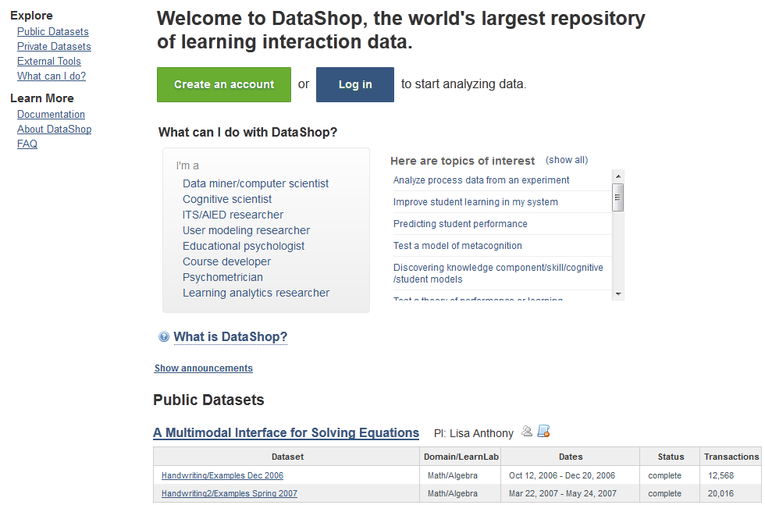

Slide 39
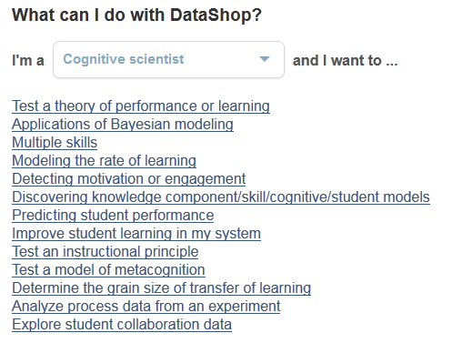

Slide 40
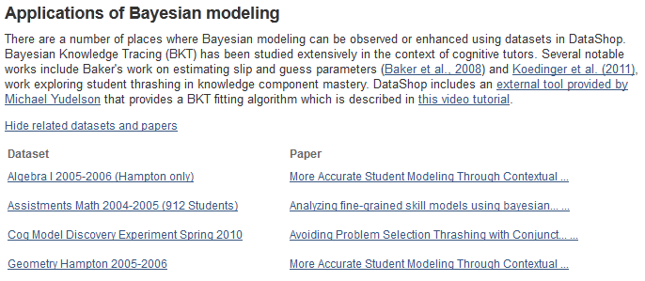
View dataset by clicking on name
Download paper by clicking on title

Slide 41
Learning curve categorization
New Feature
Find which curves are low and flat, still high, have no learning, or have too little data
LearnLab DataShop
datashop-help@lists.andrew.cmu.edu
pslcdatashop.org

Slide 42
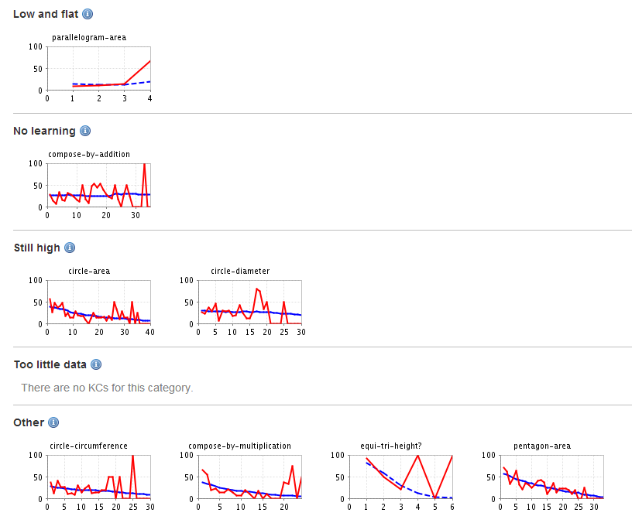
Students likely received too much practice for these KCs. Consider reducing thre required number of tasks.
No apparent learning for these KCs. Consider splitting KC.
Students continued to have difficulty with these KCs. Consider increasing opportunities for practice
Students didn't practice these KCs enough for the data to be interpretable.

Slide 43
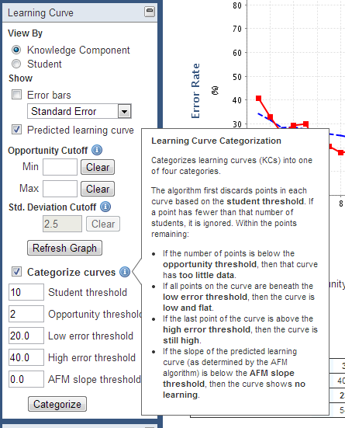

Slide 44
Import data All by yourself
New Feature
Automatic verification and import of tab-delimited data
LearnLab DataShop
datashop-help@lists.andrew.cmu.edu
pslcdatashop.org

Slide 45
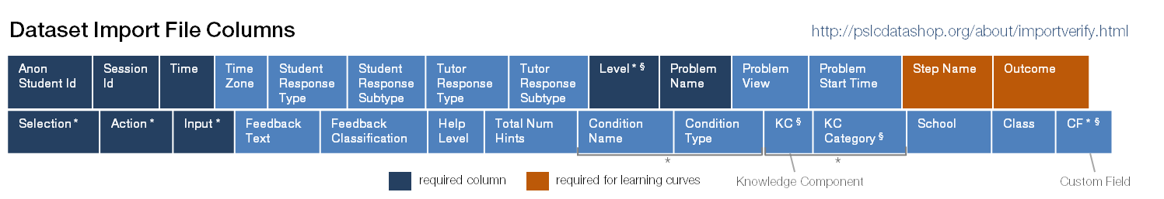
Data Format
Tab-delimited text
Required columns:
Anon Student Id
Session Id
Time
Level
Problem Name
Step Name
Outcome
Selection, Action, Input

Slide 46
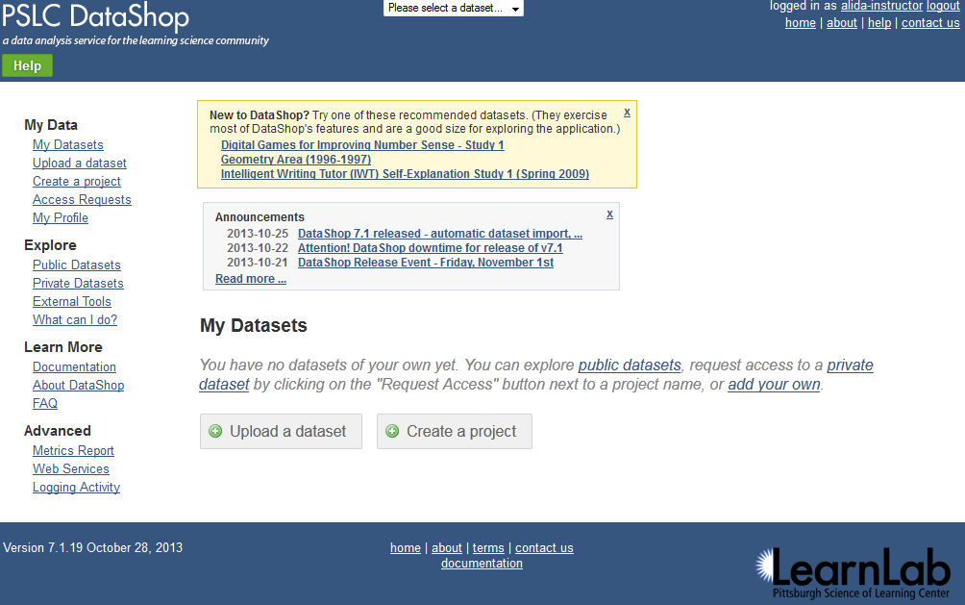

Slide 47
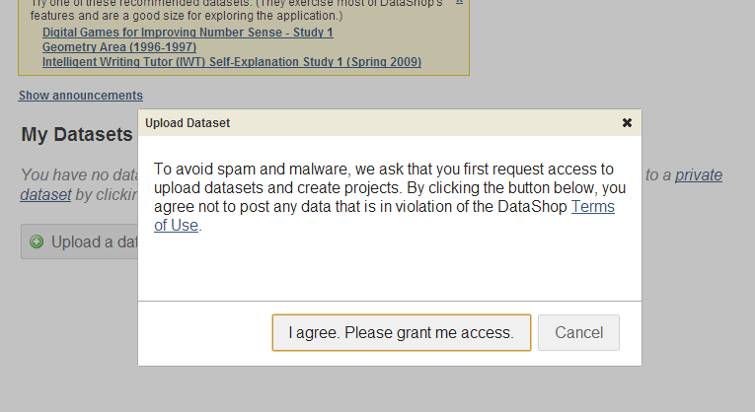

Slide 48
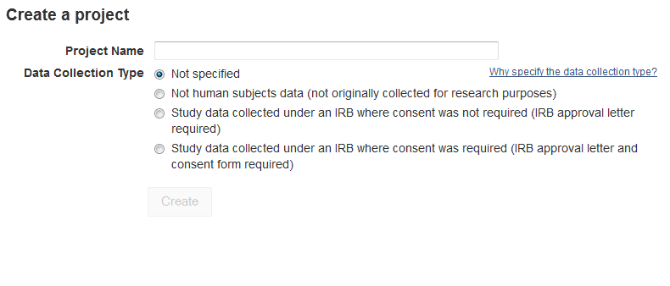

Slide 49
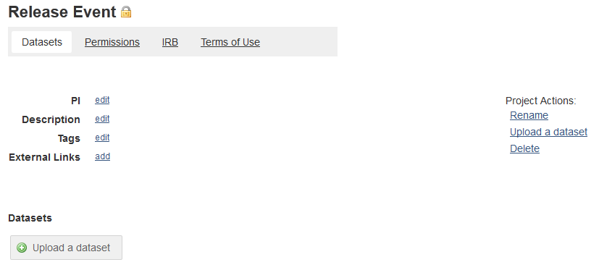

Slide 50
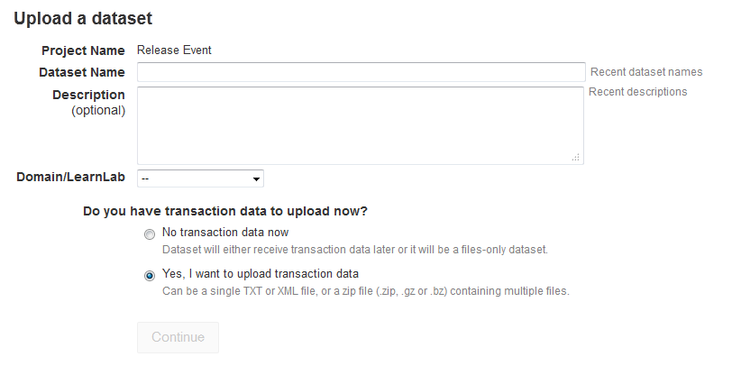

Slide 51
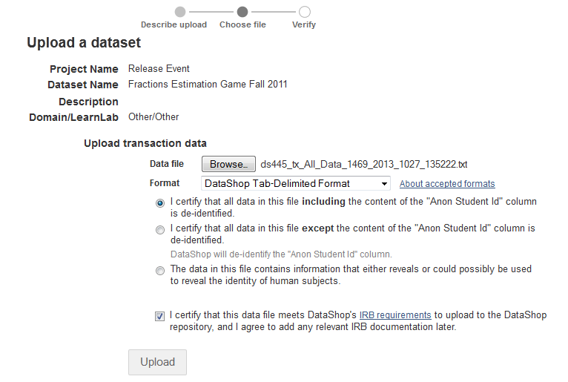

Slide 52
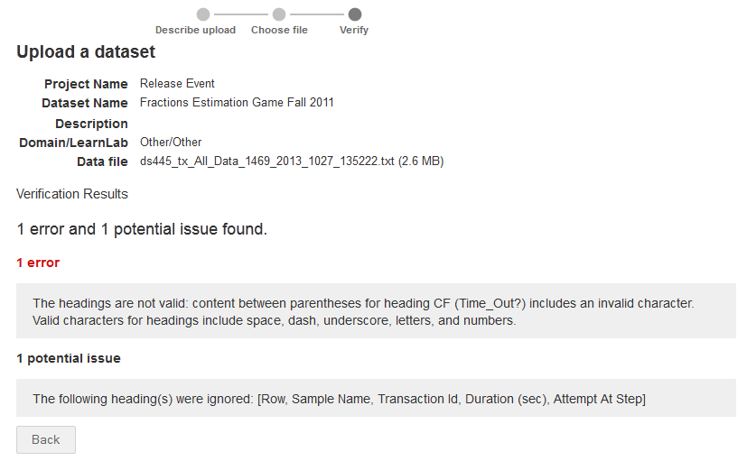

Slide 53
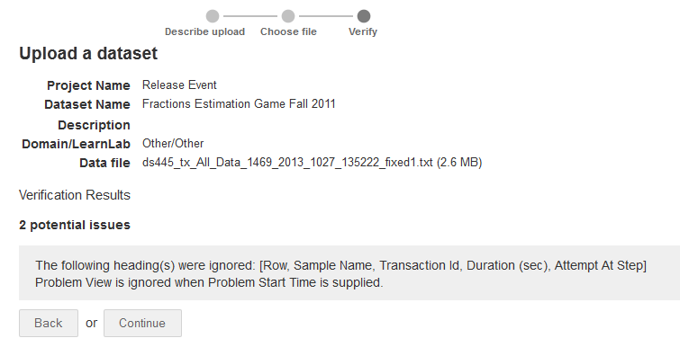

Slide 54
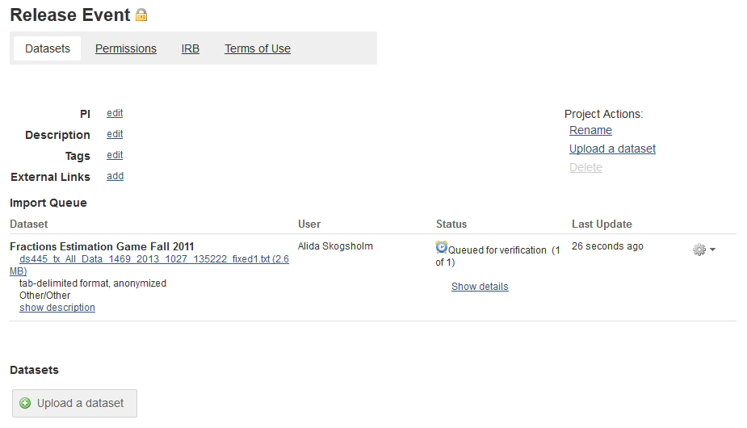
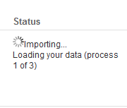
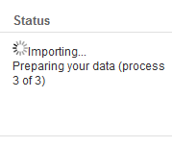
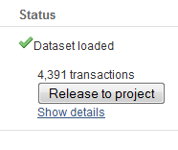

Slide 55
Custom fields
The Tools
Add, set and view custom data through web services.
LearnLab DataShop
datashop-help@lists.andrew.cmu.edu
pslcdatashop.org

Slide 56
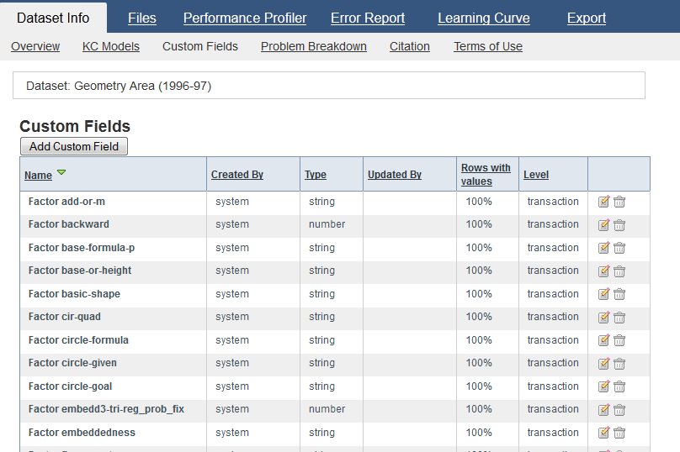

Slide 57
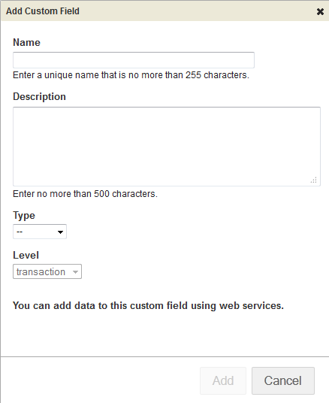
Add Custom Field
Either through UI or Web Service
java -jar dist/datashop-webservices.jar file cf_add.xml
"http://localhost:8080/services/datasets/1/customfields/add"
<?xml version="1.0" encoding="UTF-8"?>
<pslc_datashop_message>
<custom_field>
<name>bkt1</name>
<description>blah blah</description>
<type>number</type>
<level>transaction</level>
</custom_field>
</pslc_datashop_message>

Slide 58
Hands-on
Learn how to get started, analyze cog models, or try out the categorization
LearnLab DataShop
datashop-help@lists.andrew.cmu.edu
pslcdatashop.org

Slide 59
Hands-on
Creating an account
Export formats
Exploring research goals
Try a tool
Learning curve analysis
Performance Profiler
Importing data
Web services

Slide 60
PREVIOUS SLIDES

Slide 61
Let us know what you need!
Feature Request wiki is available here:
http://www.learnlab.org/research/wiki/index.php/DataShop_Feature_Wish_List
LearnLab DataShop
datashop-help@lists.andrew.cmu.edu
pslcdatashop.org

Slide 62
Importing into DataShop
LearnLab DataShop
datashop-help@lists.andrew.cmu.edu
pslcdatashop.org

Slide 63
Types of Imports
Flat File – Tab delimited file
XML – follows the tutor message format
Logging Libraries (Java, Flash)
Custom Import (Carnegie Learning)
LearnLab DataShop
datashop-help@lists.andrew.cmu.edu
pslcdatashop.org

Slide 64
Exporting Data
LearnLab DataShop
datashop-help@lists.andrew.cmu.edu
pslcdatashop.org

Slide 65
3 data formats for exporting
Transaction
Export > By Transaction.
Data at the finest level of granularity possible—the level at which it was logged.
Student-Step
Export > By Student-Step.
Data aggregated by student-step: each row represents a student attempting to complete a step.
Student-Problem
Export > By Student-Problem.
Data aggregated by student and problem, describing unique problems students have engaged in.
LearnLab DataShop
datashop-help@lists.andrew.cmu.edu
pslcdatashop.org
Notes:
There are three ways to get data out of DataShop. You can see the columns on the reference sheet we handed out. Maybe the primary tool you use is Excel or SPSS. You can get your data out of DataShop to use the data in these tools. If you use Excel, be aware that Excel tends to automatically format the date/time/number fields for you, possibly resulting in data loss!

Slide 66
3 data formats for exporting
Choosing a format depends on your analysis
Do you want to examine the time students took after hints or incorrect attempts?
Do you want to find difficult problems or steps in a curriculum?
Do you want to find time on steps when first attempt was correct vs. time on steps when first attempt was incorrect?
Do you want to look at student responses and feedback given?
LearnLab DataShop
datashop-help@lists.andrew.cmu.edu
pslcdatashop.org
Notes:
There are three ways to get data out of DataShop. You can see the columns on the reference sheet we handed out. Maybe the primary tool you use is Excel or SPSS. You can get your data out of DataShop to use the data in these tools. If you use Excel, be aware that Excel tends to automatically format the date/time/number fields for you, possibly resulting in data loss!

Slide 67
Places to export
From the web application
From web services
How can I programmatically retrieve data from DataShop? (And later, store the results of analyses back to DataShop.)
LearnLab DataShop
datashop-help@lists.andrew.cmu.edu
pslcdatashop.org
Notes:
There are three ways to get data out of DataShop. You can see the columns on the reference sheet we handed out. Maybe the primary tool you use is Excel or SPSS. You can get your data out of DataShop to use the data in these tools. If you use Excel, be aware that Excel tends to automatically format the date/time/number fields for you, possibly resulting in data loss!

Slide 68
Places to export
From the web application:
Export > By transaction
Export > By student-step
Export > By student-problem
Dataset Info > KC Models
Dataset Info > Problem Breakdown
LearnLab DataShop
datashop-help@lists.andrew.cmu.edu
pslcdatashop.org
Notes:
There are three ways to get data out of DataShop. You can see the columns on the reference sheet we handed out. Maybe the primary tool you use is Excel or SPSS. You can get your data out of DataShop to use the data in these tools. If you use Excel, be aware that Excel tends to automatically format the date/time/number fields for you, possibly resulting in data loss!

Slide 69
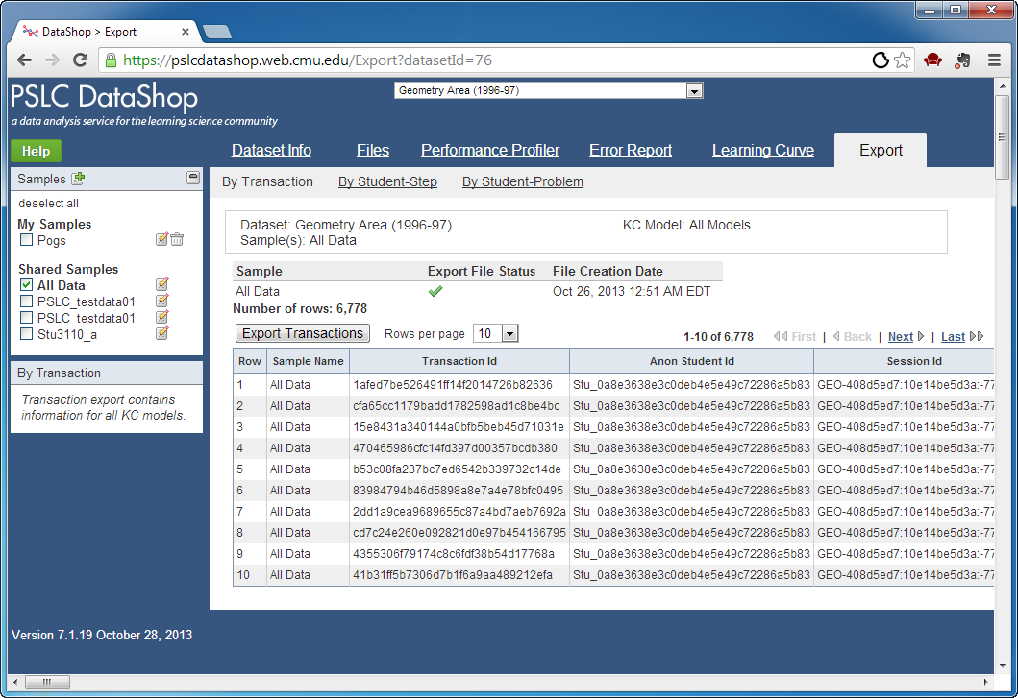
Export > By transaction
Look for the green check to see if that sample can be exported quickly

Slide 70
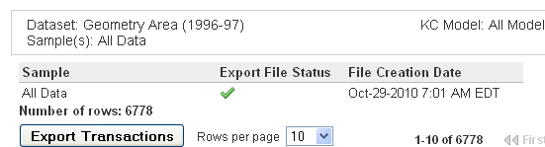
LearnLab DataShop
datashop-help@lists.andrew.cmu.edu
pslcdatashop.org
Notes:
Be aware that on the transaction export, we try to cache the file ahead of time so that the export is fast. Look at this table to see the status for the sample or samples you are exporting. This does not apply to the student-step and student-problem rollups, only the transaction format.

Slide 71
Places to export
From web services:
By transaction
By student-step
Request only some columns
Request only some rows
LearnLab DataShop
datashop-help@lists.andrew.cmu.edu
pslcdatashop.org

Slide 72
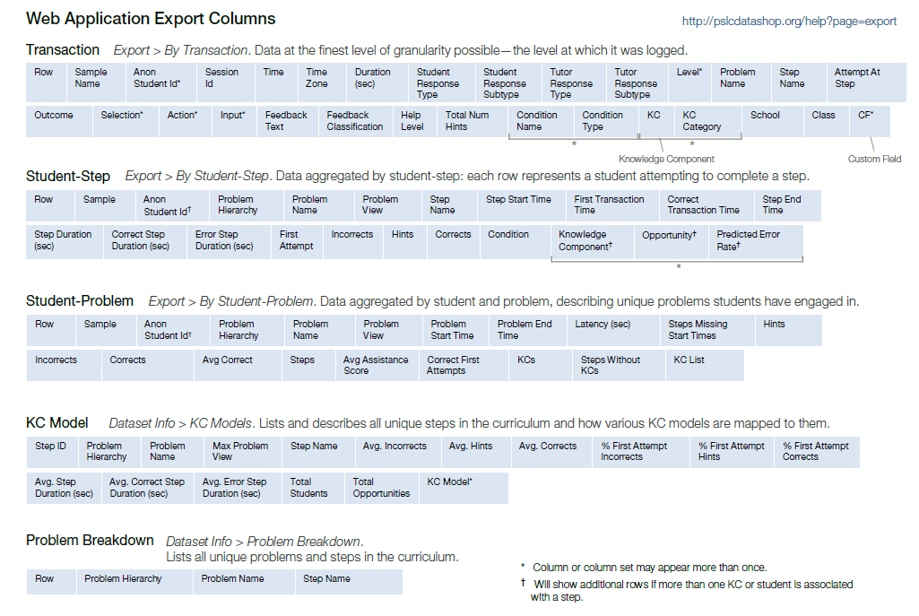
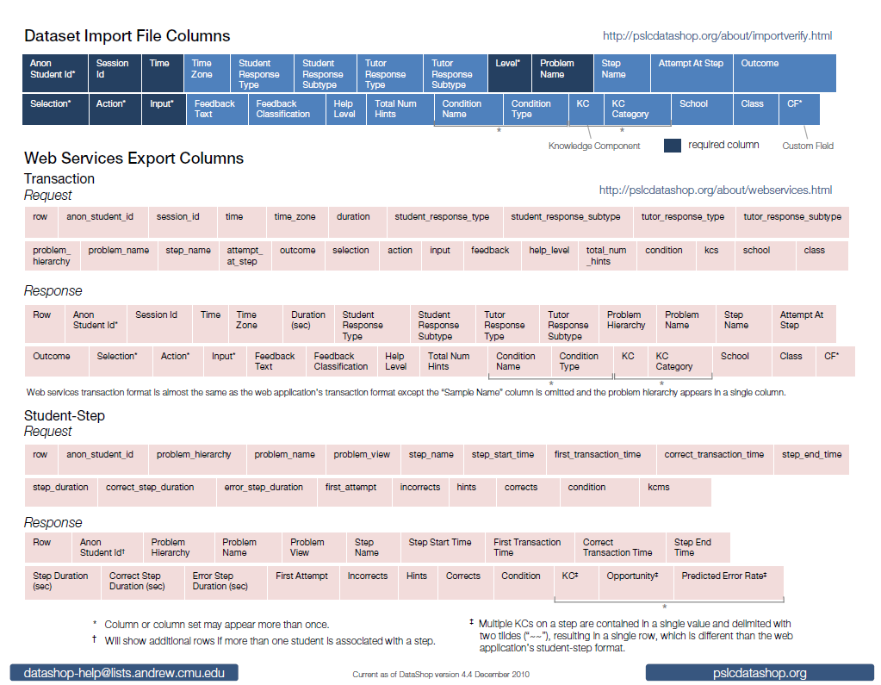
Export columns
Names of columns documented on your cheat sheet:
More extensive documentation available at: http://pslcdatashop.org/help?page=export
LearnLab DataShop
datashop-help@lists.andrew.cmu.edu
pslcdatashop.org
More extensive documentation available at: http://pslcdatashop.org/help?page=export

Slide 73
Transaction Export Columns
Some columns appear in pairs or sets
Condition Name and Condition Type
KC and KC Category
Some columns or column sets can appear more than once
The above columns
CF (custom field)
Level
Select, Action, and Input
LearnLab DataShop
datashop-help@lists.andrew.cmu.edu
pslcdatashop.org

Slide 74
Student-Step Export Columns
Some columns appear in pairs or sets
KC, Opportunity, Predicted Error Rate
Additional rows for a single step will appear if more than one KC or student is associated with a step
LearnLab DataShop
datashop-help@lists.andrew.cmu.edu
pslcdatashop.org

Slide 75
Web Services Export Columns
Differ slightly from the equivalent formats in the web application.
See cheat sheet for more info
LearnLab DataShop
datashop-help@lists.andrew.cmu.edu
pslcdatashop.org

Slide 76
Slides from the introduction to Datashop workshop

Slide 77
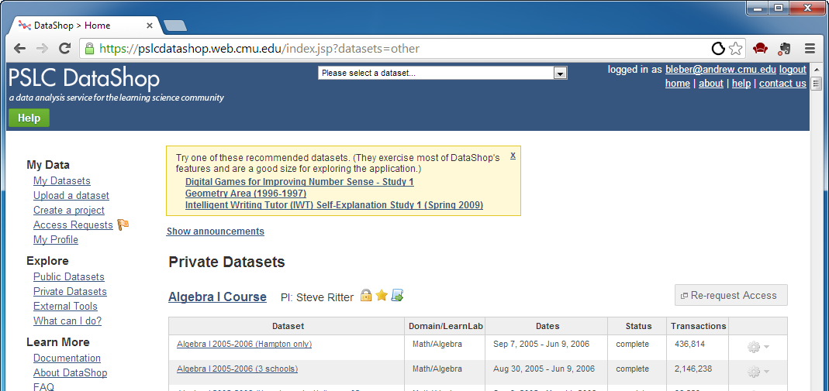
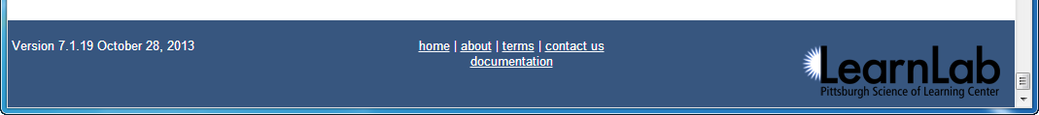
2
1
There are 3 places to click to get help on how to use DataShop!
3
Notes:
CHECK POINT: Make sure all the participants are on this page.

Slide 78
1
Click the green help button to get help on the page you are currently on.
PSLC DataShop
datashop-help@lists.andrew.cmu.edu
pslcdatashop.org

Slide 79
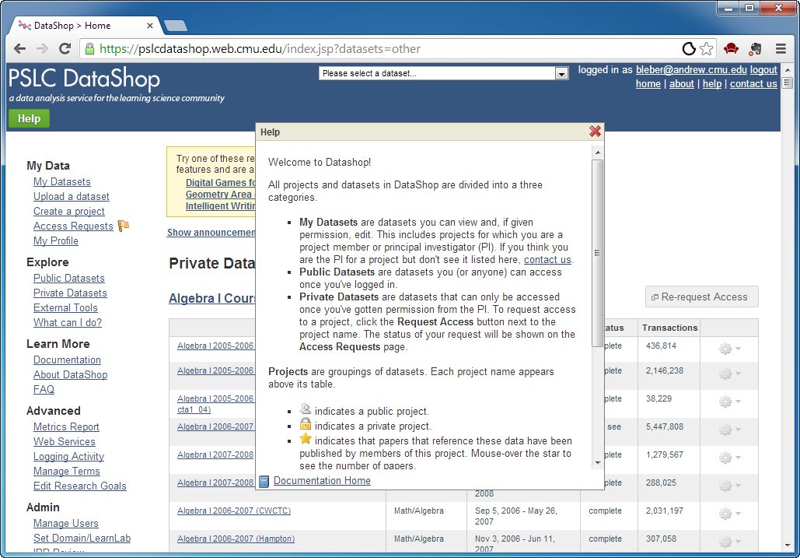

Slide 80
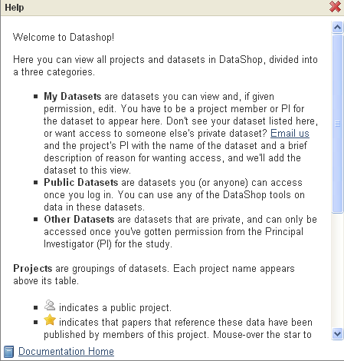
Click on
‘Documentation Home’ to get more information on this topic in our help pages.

Slide 81
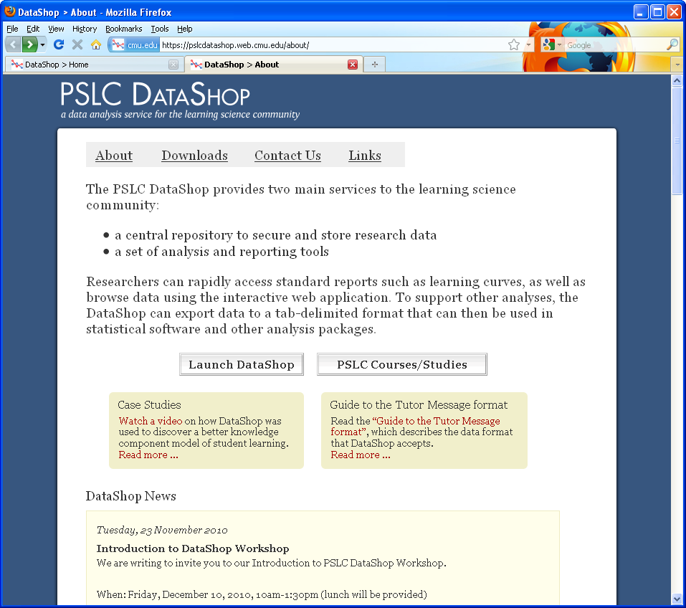

Introduction to PSLC DataShop
December 2010
Notes:
This is our project page where we post news. Its also where you can download the logging library tools, the validation tools, and other downloads.

Slide 82
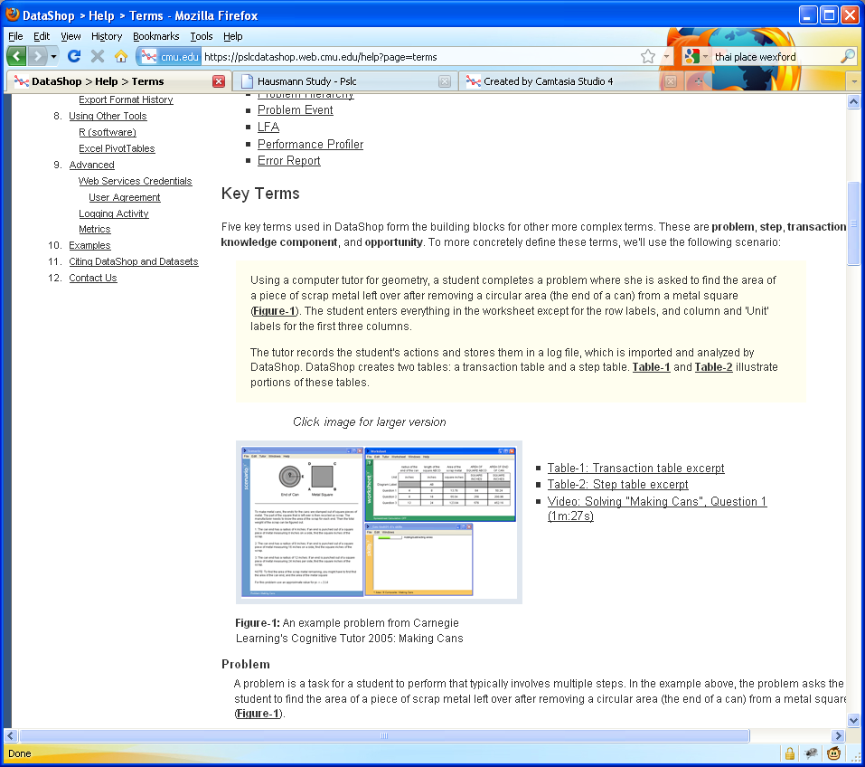
We use the “Making Cans” problem from the Cognitive Tutor as an example to explain the key terms used in DataShop
Watch this video to see how this tutor works

Slide 83
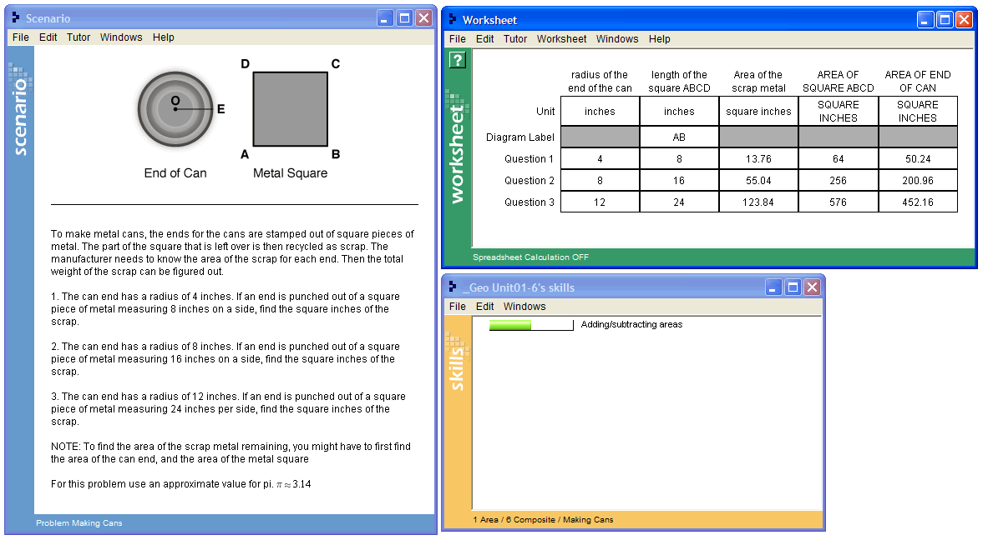
Problem: “Making Cans”

Slide 84
Steps
SCRAP-METAL-AREA Q1
SQUARE-BASE Q1
SQUARE-AREA Q1
POG-RADIUS Q1
POG-AREA Q1

Slide 85
Transactions
Row | Student | Problem | Step | Attempt | Input | Evaluation | KC
9 | S01 | MAKING-CANS | (POG-RADIUS Q1) | 1 | 4 | CORRECT | Enter-Given
10 | S01 | MAKING-CANS | (SQUARE-BASE Q1) | 1 | 8 | CORRECT | Enter-Given
11 | S01 | MAKING-CANS | (SCRAP-METAL-AREA Q1) | 1 | 32 | INCORRECT
12 | S01 | MAKING-CANS | (SCRAP-METAL-AREA Q1) | 2 | 4 | INCORRECT
13 | S01 | MAKING-CANS | (SQUARE-AREA Q1) | 1 | 64 | CORRECT | Square-Area
14 | S01 | MAKING-CANS | (POG-AREA Q1) | 1 | 50.24 | CORRECT | Circle-Area
15 | S01 | MAKING-CANS | (SCRAP-METAL-AREA Q1) | 3 | 13.76 | CORRECT | Compose-Areas
Notes:
Define KC and KC Model.

Slide 86
Student-Steps
Row | Student | Problem | Step | Opportunity | Total Incorrects | Total Hints | Assistance Score | Error Rate | KC
6 | S01 | MAKING-CANS | (POG-RADIUS Q1) | 2 | 0 | 0 | 0 | 0 | Enter-Given
7 | S01 | MAKING-CANS | (SQUARE-BASE Q1) | 3 | 0 | 0 | 0 | 0 | Enter-Given
8 | S01 | MAKING-CANS | (SQUARE-AREA Q1) | 1 | 0 | 0 | 0 | 0 | Square-Area
9 | S01 | MAKING-CANS | (POG-AREA Q1) | 2 | 0 | 0 | 0 | 0 | Circle-Area
10 | S01 | MAKING-CANS | (SCRAP-METAL-AREA Q1) | 2 | 2 | 0 | 2 | 1 | Compose-Areas
Notes:
Opportunity relative to KC. A chance for a student to demonstrate that he or she has learned a KC.

Slide 87
Opportunity: a chance for a student to demonstrate that he or she has learned a KC.
Row | Student | Problem | Step | Opportunity | Total Incorrects | Total Hints | Assistance Score | Error Rate | KC
6 | S01 | MAKING-CANS | (POG-RADIUS Q1) | 2 | 0 | 0 | 0 | 0 | Enter-Given
7 | S01 | MAKING-CANS | (SQUARE-BASE Q1) | 3 | 0 | 0 | 0 | 0 | Enter-Given
8 | S01 | MAKING-CANS | (SQUARE-AREA Q1) | 1 | 0 | 0 | 0 | 0 | Square-Area
9 | S01 | MAKING-CANS | (POG-AREA Q1) | 2 | 0 | 0 | 0 | 0 | Circle-Area
10 | S01 | MAKING-CANS | (SCRAP-METAL-AREA Q1) | 2 | 2 | 0 | 2 | 1 | Compose-Areas
Notes:
Opportunity relative to KC. Increases with steps, not with transactions.

Slide 88
Observation: set of transactions for a student working on a step, i.e. each row in this table
Row | Student | Problem | Step | Opportunity | Total Incorrects | Total Hints | Assistance Score | Error Rate | KC
6 | S01 | MAKING-CANS | (POG-RADIUS Q1) | 2 | 0 | 0 | 0 | 0 | Enter-Given
7 | S01 | MAKING-CANS | (SQUARE-BASE Q1) | 3 | 0 | 0 | 0 | 0 | Enter-Given
8 | S01 | MAKING-CANS | (SQUARE-AREA Q1) | 1 | 0 | 0 | 0 | 0 | Square-Area
9 | S01 | MAKING-CANS | (POG-AREA Q1) | 2 | 0 | 0 | 0 | 0 | Circle-Area
10 | S01 | MAKING-CANS | (SCRAP-METAL-AREA Q1) | 2 | 2 | 0 | 2 | 1 | Compose-Areas
Notes:
Each row is an observation

Slide 89
The DataShop Tools
Learning Curve
Sample Selector
Error Report
Performance Profiler
Export
Import

Slide 90
Learning curve
The Tools
How can I visualize student performance over time?
LearnLab DataShop
datashop-help@lists.andrew.cmu.edu
pslcdatashop.org

Slide 91
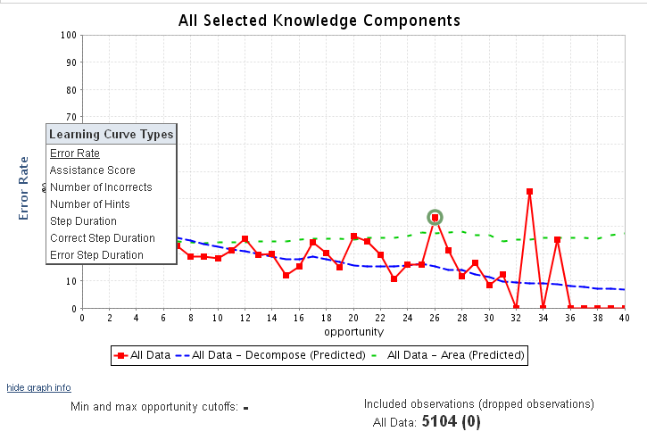
Visualizes changes in student performance over time
Hover the y-axis to change the type of Learning Curve.
Types include:
Error Rate
Assistance Score
Number of Incorrects
Number of Hints
Step Duration
Correct Step Duration
Error Step Duration
Time is represented on the x-axis as ‘opportunity’, or the # of times a student (or students) had an opportunity to demonstrate a KC

Slide 92
If you change the KC model,
you should consider changing instruction
Problem creation, selection, and sequencing
New skills or concepts (new KCs) require:
New kinds problems & instructional activities
Changes to student modeling – skillometer, knowledge tracing
Feedback and hint message content
One KC becomes two => need new hint messages for new KC
New error feedback may be needed
Even interface design – “make thinking visible”
If multiple KC per step => break down by adding new intermediate steps to interface
Notes:
Can’t do this IN DataShop, but worth considering the implications.

Slide 93
If interested in KC modeling …
Related tools
Model Values (Learning Curve > Model Values)
KC Models (Dataset Info > KC Models)
… but most tools in DataShop benefit from having a reasonable KC model.

Slide 94
Sample selector
The Tools
LearnLab DataShop
datashop-help@lists.andrew.cmu.edu
pslcdatashop.org

Slide 95


Slide 96
Sample Selector
Not samples in the statistical sense—these are subsets of data
You can make your own
e.g., filter on condition if that’s encoded in the data
You can switch between them, or show more than one sample
Notes:
e.g., on learning curve shows line per sample.

Slide 97
Performance profiler
The Tools
What was the hardest problem for students? How many students worked in a particular unit?
LearnLab DataShop
datashop-help@lists.andrew.cmu.edu
pslcdatashop.org

Slide 98

Change the settings for this tool using the options on the left hand side of the page
Change the sort order here
Set a minimum number of students to filter out problems not seen by many students

Slide 99




Change how the selected measure is aggregated by hovering the title for the x-axis.
Change the selected measure by hovering the title for the y-axis.
See more details by hovering a bar in the graph.

Slide 100
Error report
The Tools
How can I explore the errors students made and drill down to see actual responses and feedback?
LearnLab DataShop
datashop-help@lists.andrew.cmu.edu
pslcdatashop.org

Slide 101

Change the settings for this tool using the options on the left hand side of the page
PSLC DataShop
datashop-help@lists.andrew.cmu.edu
pslcdatashop.org

Slide 102

The number of observations by type (correct, hint, or incorrect)
Details what the student actual typed into the tutor
PSLC DataShop
datashop-help@lists.andrew.cmu.edu
pslcdatashop.org
Notes:
Find a common error in English article usage

Slide 103
Documentation
For XML import:
Guide to the Tutor Message Format: http://pslcdatashop.org/dtd/guide/
For tab-delimited format import:
http://pslcdatashop.org/about/importverify.html
To learn about terminology:
http://pslcdatashop.org/help?page=terms
To learn about existing DataShop output formats:
http://pslcdatashop.org/help?page=export
Recommended!
Notes:
Here are some documentation pointers.

