Slide 1

Introduction to
PSLC DataShop
http://pslcdatashop.org
Friday, December 10, 2010
PSLC DataShop
datashop-help@lists.andrew.cmu.edu
pslcdatashop.org

Slide 2

The DataShop Team
John Stamper - DataShop Technical Director
Alida Skogsholm - DataShop Manager, Developer
Brett Leber - Interaction Designer
Duncan Spencer - DataShop Developer
Shanwen Yu - DataShop Developer
Sandy Demi - QA (Quality Assurance – Testing)
Ken Koedinger - PSLC Director
Jo Bodnar – PSLC Admin
Introduction to PSLC DataShop
December 2010

Slide 3
What is DataShop?
Central Repository
  Secure place to store & access research data
    Every LearnLab and every study
  Supports various kinds of research
    Primary analysis of study data
    Exploratory analysis of course data
    Secondary analysis of any data set
Analysis & Reporting Tools
  Focus on student-tutor interaction data
  Learning curves & error reports provide summary and low-level views of student performance
  Performance Profiler aggregates across various levels of granularity (problem, dataset levels, knowledge components, etc.)
  Data Export
    Tab delimited tables you can open with your favorite spreadsheet program or statistical package
  New tools created to meet highest demands
Introduction to PSLC DataShop
December 2010

Slide 4
Repository
Domain | Files | Papers | Datasets | Student Actions | Students | Student Hours
Language | 51 | 10 | 63 | 3,063,195 | 4,753 | 4,412.95
Math | 140 | 45 | 101 | 35,715,976 | 18,809 | 105,966.11
Science | 79 | 19 | 45 | 5,656,005 | 7,689 | 16,365.13
Other | 13 | 12 | 29 | 4,801,163 | 8,060 | 18,007.91
Total | 283 | 86 | 238 | 49,236,339 | 39,311 | 144,752.10
Introduction to PSLC DataShop
December 2010

Slide 5
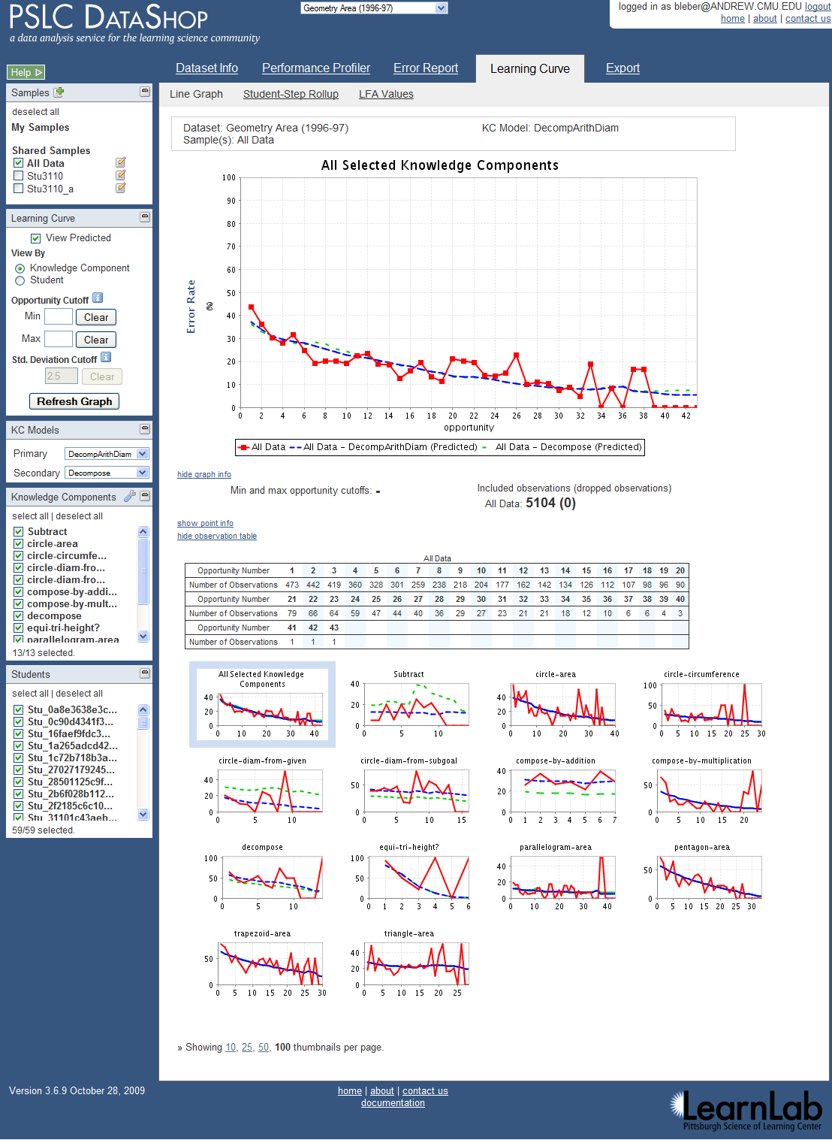
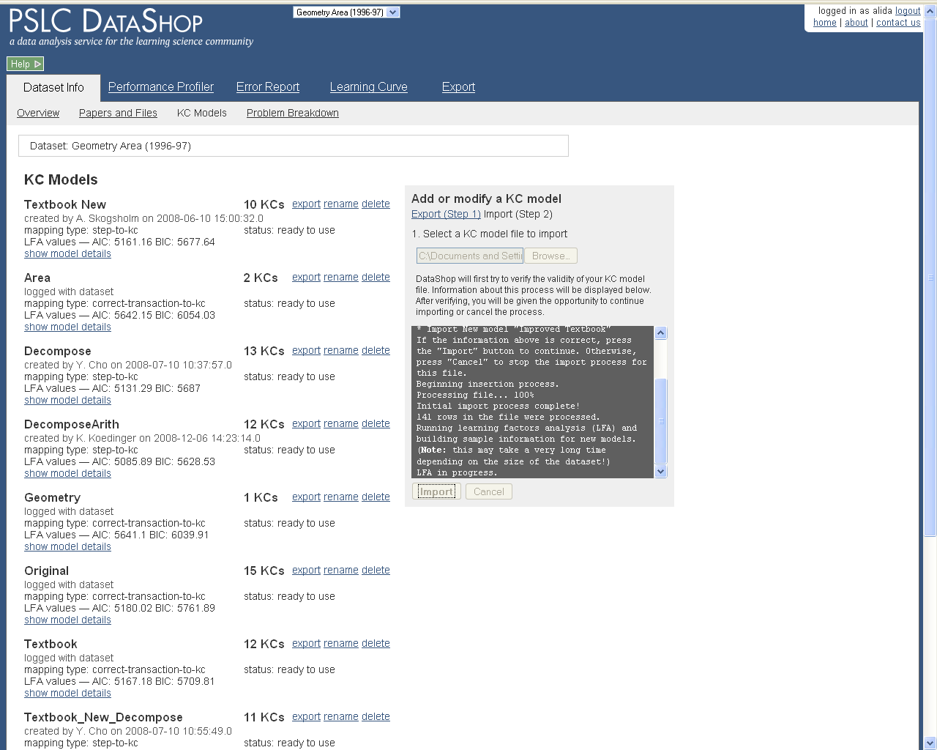
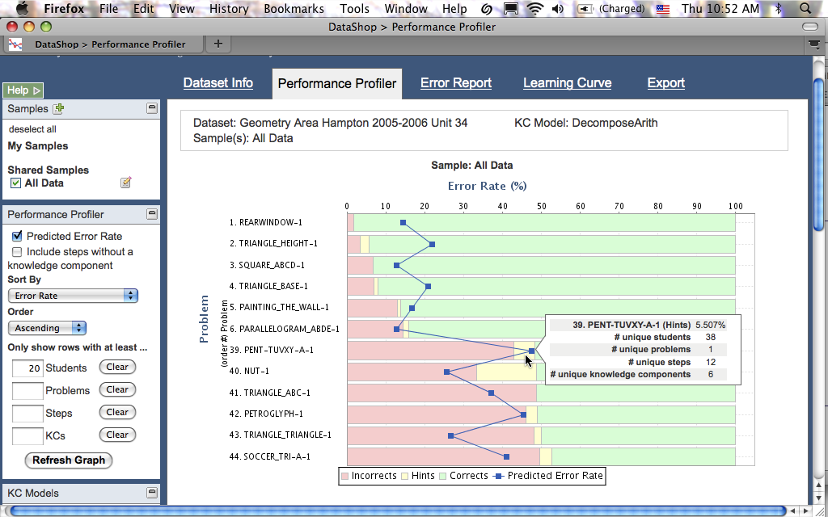
Web Application
Introduction to PSLC DataShop
December 2010

Slide 6
DataShop, what’s in it for me?
Free tools to analyze your data
Free researchers to analyze your data
Place to collaborate
Real opportunities to validate ideas across multiple data sets
Introduction to PSLC DataShop
December 2010

Slide 7
Let us know what you need!
  Feature Request wiki is available here:
  http://www.learnlab.org/research/wiki/index.php/DataShop_Feature_Wish_List
Introduction to PSLC DataShop
December 2010

Slide 8
Today’s Schedule
10:00 - 10:15 Introduction to DataShop
10:15 - 11:00 DataShop Hands On
11:00 - 11:15 Break
11:15 - 12:00 Case study with Marsha Lovett
12:00 - 13:30 Q&A -- Lunch
Introduction to PSLC DataShop
December 2010

Slide 9
Please fill out our survey!
http://snipr.com/dsworkshop
Introduction to PSLC DataShop
December 2010
Notes:
https://spreadsheets.google.com/viewform?formkey=dElRMGMzY3BMUTBLR2hyTjg2cGpfeEE6MQ

Slide 10
Enjoy!
http://pslcdatashop.org
datashop-help@lists.andrew.cmu.edu
Introduction to PSLC DataShop
December 2010

