Slide 1
PSLC DataShop Introduction
http://pslcdatashop.org
Slides current to DataShop version 4.1.8
John Stamper
DataShop Technical Director
Notes:
Welcome and thank you for attending our winter workshop. We hope you find it educational, enlightening, magical, fun and just an overall perfect use of your time ☺..
I’d like to introduce myself – I’m Kyle Cunningham, DataShop Consultant. I’ll be providing a brief overview of DataShop, focusing on the following topics:
What IS DataShop?
How do I get data in?
OK, now what?

Slide 2
The DataShop Team
John Stamper
DataShop Technical Director
Sandy Demi
QA (Quality Assurance – Testing)
Brett Leber
Interaction Designer
Alida Skogsholm
DataShop Manager, Developer
Duncan Spencer
DataShop Developer
Shanwen Yu
DataShop Developer
Notes:
Before we dig in, I’d like to introduce the star lineup of DataShop:
-
We make the magic happen, folks ☺

Slide 3
What is DataShop?
Central Repository
Secure place to store & access research data
Every LearnLab and every study
Supports various kinds of research
Primary analysis of study data
Exploratory analysis of course data
Secondary analysis of any data set
Analysis & Reporting Tools
Focus on student-tutor interaction data
Learning curves & error reports provide summary and low-level views of student performance
Performance Profiler aggregates across various levels of granularity (problem, dataset levels, knowledge components, etc.)
Data Export
Tab delimited tables you can open with your favorite spreadsheet program or statistical package
New tools created to meet highest demands
Notes:
So, what exactly is DataShop?
Well, first it is a central repository for all of the data generated by PSLC studies and courses. The goal is to eventually have all of the data from learnlab studies and courses safely tucked away in DataShop for safe keeping.
Once data is in, users can conduct primary, secondary and exploratory analysis of datasets.
Second, DataShop provides analysis and reporting tools. It’s a place where researchers can jumpstart analyses – perhaps by drilling down on student performance data through the Performance Profiler or viewing learning trends through the Learning Curve tool.
You can also get data out through various export options.

Slide 4
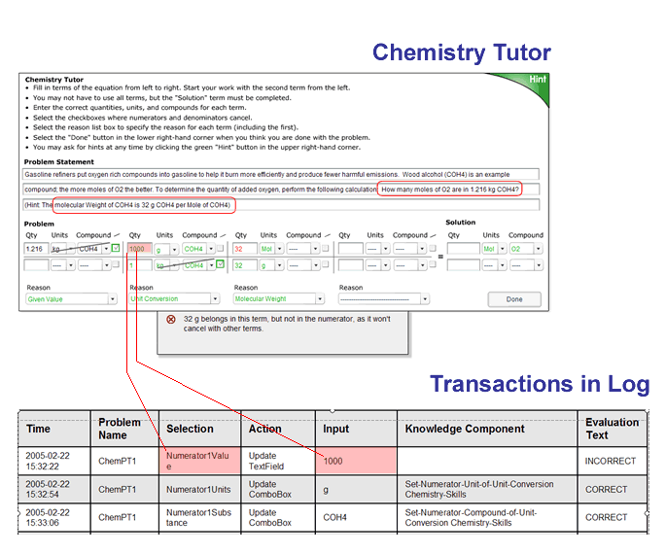
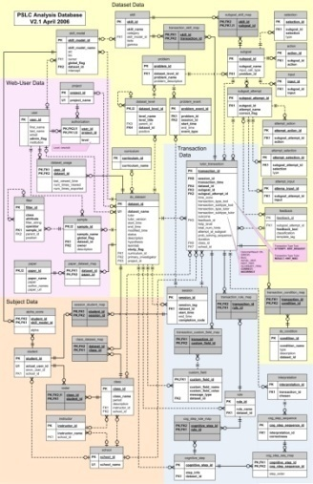
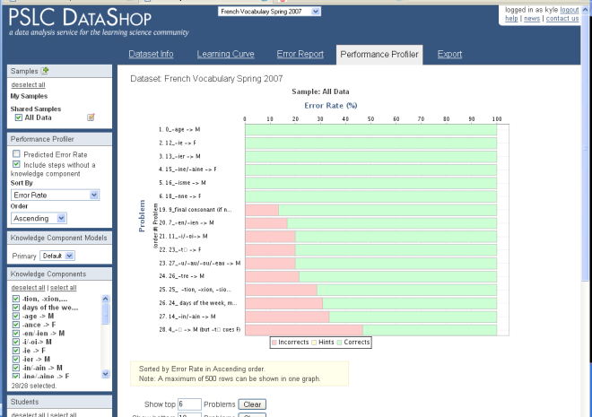
How do I get data in?
1
2
3
Collect
Store
Report
Tutors log to a standard log format
Data is captured in files or sent to the logging database
Older data can be transformed to the tutor logging format
DataShop
…converts log data to a uniform XML Format
…anonymizes participant identifiers
…imports data into a relational database
DataShop
…provides visualization and reports for researchers to analyze their data
…can export the data to a tab-delimited format
Notes:
Here’s a simplified – very simplified – depiction of how we get data into DataShop.
We can break it down into 3 steps
Collection (through tutors, for example)
Storage (convert, anonymize and import into DataShop)
Reporting (analyze with various tools, export for other types of analyses)

Slide 5
How do I get data in?
Directly
Some tutors are logging directly to the PSLC logging database
CTAT-based tutors (when configured correctly)
Indirectly
Other tutors are logging to their own file formats or their own databases
These data require a conversion process
Many studies are in this category
Notes:
We have an XML-based logging standard that makes it easy to create and process log data.
There are 2 ways this data can make it’s way into DataShop
Directly – tutors log directly to the PSLC logging database and presto magic the data appears in DataShop
Indirectly – this could be data logged by a proprietary tutor or system, such as a Carnegie Learning Tutor, or the REAP tutor. This data requires a conversion process to make it DataShop ready.

Slide 6

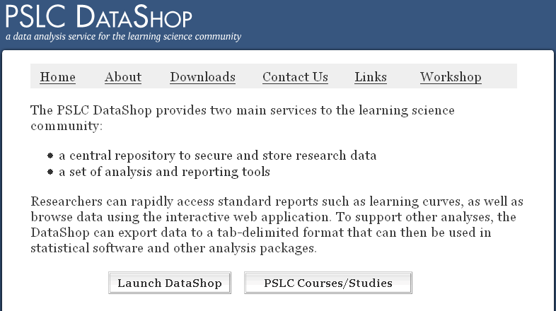
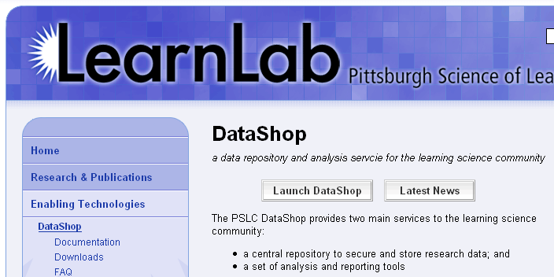
Getting to DataShop
Explore data through the DataShop tools
Where is DataShop?
http://pslcdatashop.org
Linked from DataShop homepage and learnlab.org
http://pslcdatashop.web.cmu.edu/about/
http://learnlab.org/technologies/datashop/index.php
Notes:
OK, so your data is now in DS – what do you do with it now?
This is where the analysis tools come in handy.
To play around with the tools, you can log into DS. This slide shows you two ways of doing that – launching via our homepage or from the learnlab.org site.

Slide 7
Creating an account
On DataShop's home page, click "Sign up now". Complete the form to create your DataShop account.
If you’re a CMU student/staff/faculty, click “Log in with WebISO” to create your account.

Slide 8
Getting access to datasets
By default, you will have access to the public datasets.
Of these, we recommend three for getting started:
Geometry Area (1996-1997)
Joint Explanation - Electric Fields - Pitt - Spring 2007
Chinese Vocabulary Fall 2006
For access to other datasets, contact us: datashop-help@lists.andrew.cmu.edu

Slide 9
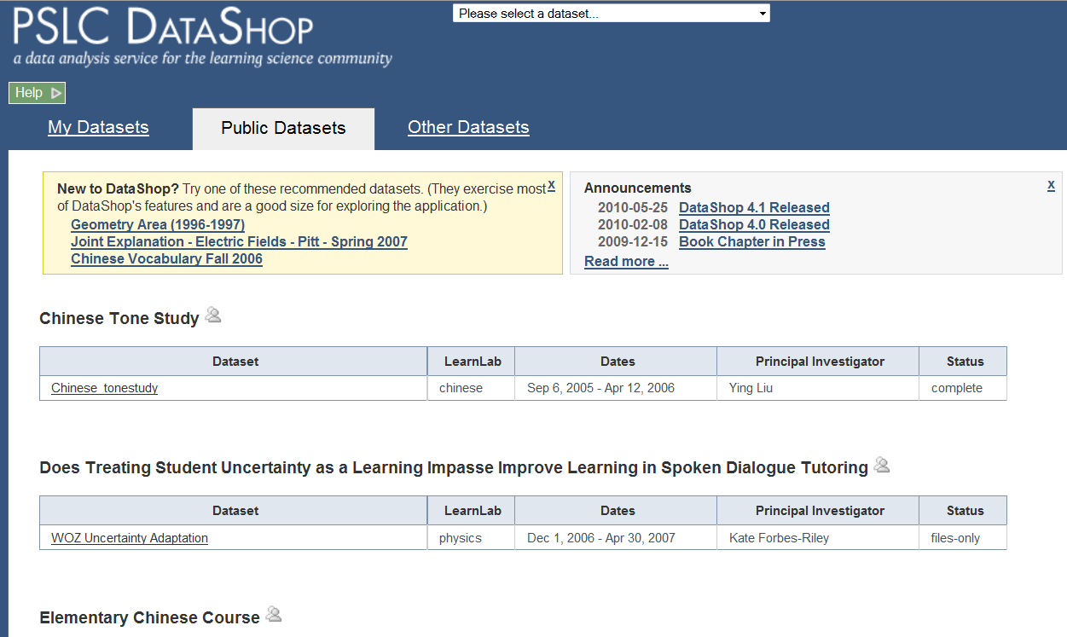
DataShop – Dataset selection
Private datasets you can’t view. Email us and the PI to get access.
Datasets you can view or edit. You have to be a project member or PI for the dataset to appear here.
Public datasets that you can view only.
Notes:
After logging into DS this is your starting screen – the projects page.
These tabs list all available data within DS. Here’s what the 3 tabs mean:
My Datasets – these are datasets you can view and edit. You have to have permission to see these.
Public Datasets – these are ones that are publicly available and ones you can only view, not edit.
Other Datasets – these are private datasets you can’t view. If you are interested in gaining access to a private dataset you can send us as well as the PI for that dataset an email requesting access.
Even if you can't edit the dataset, you can use the DataShop tools with it.

Slide 10
Important Terms
Transaction
Step
Sample
KC (Knowledge Component)
Opportunity
Observation
LFA
AIC
BIC
see http://pslcdatashop.org/help?page=terms

Slide 11
Important Terms
Transaction
A transaction is an interaction between the student and the tutoring system.
Students may make incorrect entries or ask for hints before getting a step correct. Each hint request, incorrect attempt, or correct attempt is a transaction; and a step can involve one or more transactions.
Step
A step is an observable part of the solution to a problem. Because steps are observable, they are partly determined by the user interface available to the student for solving the problem.

Slide 12
Important Terms
Sample
a subset of the data
the Sample Selector provides the ability to filter on various aspects of the data
You can use samples to:
Compare across conditions
Narrow the scope of data analysis to a specific time range, set of students, problem category, or unit of a curriculum (for example)
The columns available to filter on are organized into categories. The categories are:
Condition, Dataset Level, Problem, School, Student, Tutor Transaction

Slide 13
Important Terms
KC, Knowledge Component
a piece of information that can be used to accomplish tasks, perhaps along with other knowledge components. Knowledge component is a generalization of everyday terms like concept, principle, fact, or skill, and cognitive science terms like schema, production rule, misconception, or facet.
Opportunity
An opportunity is a chance for a student to demonstrate whether he or she has learned a given knowledge component. An opportunity exists each time a step is present with the associated knowledge component.

Slide 14
Important Terms
Observation
An observation is a group of transactions for a particular student working on a particular step within a problem view. If within these constraints there is only one transaction recorded, an observation will still exist for that single transaction.
Put another way, an observation is available each time a student takes an opportunity to demonstrate a knowledge component

Slide 15
Important Terms
LFA, Learning Factors Analysis
a logistic regression method which uses a set of customized Item-Response models to predict how a student will perform for each knowledge component on each learning opportunity. LFA was developed at Carnegie Mellon by Hao Cen, Kenneth Koedinger, and Brian Junker. In DataShop, the LFA algorithm is run over each KC model of each dataset, producing data that populates predicted learning curves and other reports.

Slide 16
Important Terms
AIC, Akaike Information Criterion
a measure of the goodness of fit of a statistical model, in this case, the LFA model. It is an operational way of trading off the complexity of the estimated model against how well the model fits the data². In this way, it penalizes the model based on its complexity (the number of parameters). A lower AIC value is better.
BIC, Bayesian Information Criterion
a measure of goodness of fit of the LFA model. The BIC penalizes free parameters more strongly than does the Akaike information criterion (AIC)³. A lower BIC value is better.

