Slide 1
Improving learning by improving the cognitive model: A data-driven approach
Cen, H., Koedinger, K., Junker, B. Learning Factors Analysis - A General Method for Cognitive Model Evaluation and Improvement. 8th International Conference on Intelligent Tutoring Systems. 2006. Cen, H., Koedinger, K., Junker, B. Is Over Practice Necessary? Improving Learning Efficiency with the Cognitive Tutor. 13th International Conference on Artificial Intelligence in Education. 2007.
Koedinger, K. Stamper, J. A Data Driven Approach to the Discovery of Better Cognitive Models . 3rd International Conference on Educational Data Mining. 2010.
Koedinger, K.R., Baker, R.S.J.d., Cunningham, K., Skogsholm, A., Leber, B., Stamper, J. (in press) A Data Repository for the EDM commuity: The PSLC DataShop. To appear in Romero, C., Ventura, S., Pechenizkiy, M., Baker, R.S.J.d. (Eds.) Handbook of Educational Data Mining. Boca Raton, FL: CRC Press.
Ken Koedinger
PSLC Director

Slide 2
Why we need better expert & student models in ITS
Two key premises
Expert & student model drives instruction
Cognitive model in Cognitive Tutors determine much of ITS behavior; Same for constraints…
These models are sometimes wrong & almost always imperfect
ITS developers often build models rationally
But such models may not be empirically accurate
A correct cognitive model should predict task difficulty and transfer => generate smooth learning curves
=> Huge opportunity for ITS researchers to improve their tutors

Slide 3
Cognitive Model Determines Instruction

Slide 4
Cognitive Tutor Technology
Cognitive Model: A system that can solve problems in the various ways students can
3(2x - 5) = 9
If goal is solve a(bx+c) = d
Then rewrite as abx + ac = d
If goal is solve a(bx+c) = d
Then rewrite as abx + c = d
If goal is solve a(bx+c) = d
Then rewrite as bx+c = d/a
6x - 15 = 9
2x - 5 = 3
6x - 5 = 9
Model Tracing: Follows student through their individual approach to a problem -> context-sensitive instruction

Slide 5
Cognitive Tutor Technology
Cognitive Model: A system that can solve problems in the various ways students can
3(2x - 5) = 9
If goal is solve a(bx+c) = d
Then rewrite as abx + ac = d
If goal is solve a(bx+c) = d
Then rewrite as abx + c = d
Hint message: “Distribute a across the parentheses.”
Bug message: “You need to multiply c by a also.”
Known? = 85% chance
Known? = 45%
6x - 15 = 9
2x - 5 = 3
6x - 5 = 9
Model Tracing: Follows student through their individual approach to a problem -> context-sensitive instruction
Knowledge Tracing: Assesses student's knowledge growth -> individualized activity selection and pacing

Slide 6
If you change cognitive model you change instruction
Problem creation, selection, & sequencing
New skills or concepts (= “knowledge components” or “KCs”) require:
New kinds problems & instructional activities
Changes to student modeling – skillometer, knowledge tracing
Feedback and hint message content
One skill becomes two => need new hint messages for new skill
New bug rules may be needed
Even interface design – “make thinking visible”
If multiple skills per step => break down by adding new intermediate steps to interface

Slide 7
Expert & student models are imperfect in most ITS
How can we tell?
Don’t get learning curves
If we know tutor works (get pre to post gains), but “learning curves don’t curve”, then the model is wrong
Don’t get smooth learning curves
Even when every KC has a good learning curve (error rate goes down as student gets more opportunities to practice), model still may be imperfect when it has significant deviations from student data

Slide 8
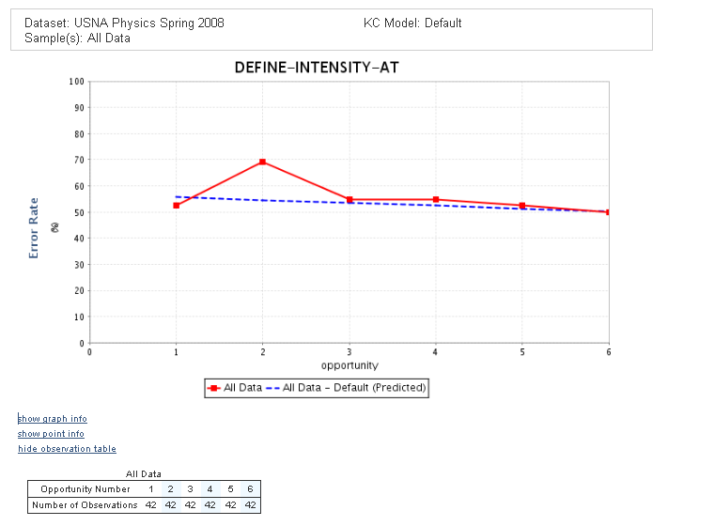

Slide 9
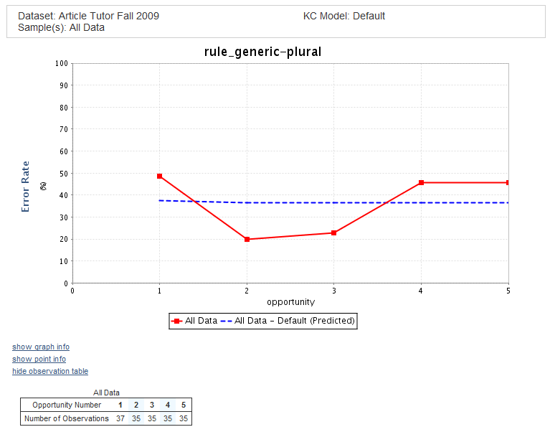

Slide 10
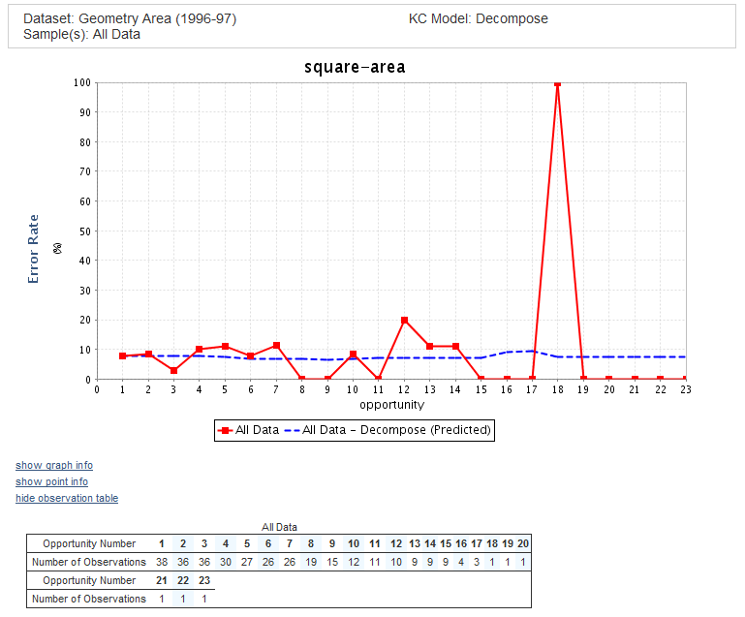

Slide 11
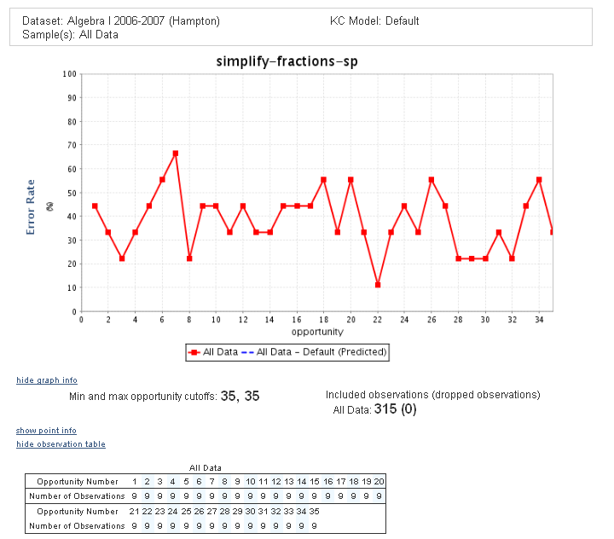

Slide 12
PSLC DataShop Tools
http://pslcdatashop.org
Slides current to DataShop version 4.1.8
Ken Koedinger
PSLC Director
Koedinger, K.R., Baker, R.S.J.d., Cunningham, K., Skogsholm, A., Leber, B., Stamper, J. (in press) A Data Repository for the EDM commuity: The PSLC DataShop. To appear in Romero, C., Ventura, S., Pechenizkiy, M., Baker, R.S.J.d. (Eds.) Handbook of Educational Data Mining. Boca Raton, FL: CRC Press.
Notes:
Welcome and thank you for attending our winter workshop. We hope you find it educational, enlightening, magical, fun and just an overall perfect use of your time ☺..
I’d like to introduce myself – I’m Kyle Cunningham, DataShop Consultant. I’ll be providing a brief overview of DataShop, focusing on the following topics:
What IS DataShop?
How do I get data in?
OK, now what?

Slide 13

Analysis Tools
Dataset Info
Performance Profiler
Error Report
Learning Curve
KC Model Export/Import
Notes:
Before we dive into the tools, here’s a quick list of what’s currently available. We’ll see each of these in futher detail momentarily.

Slide 14
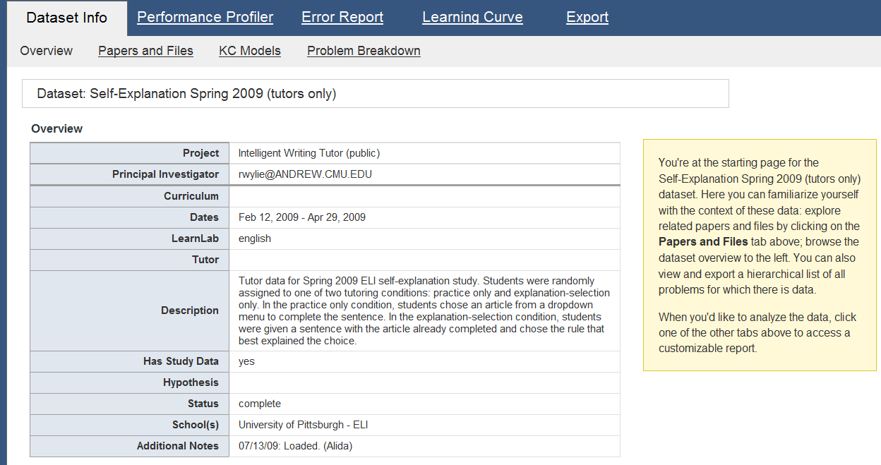
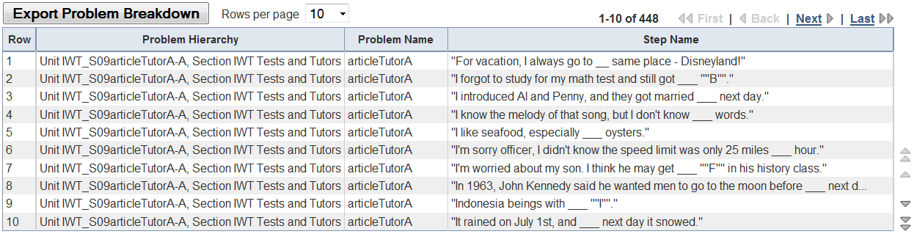
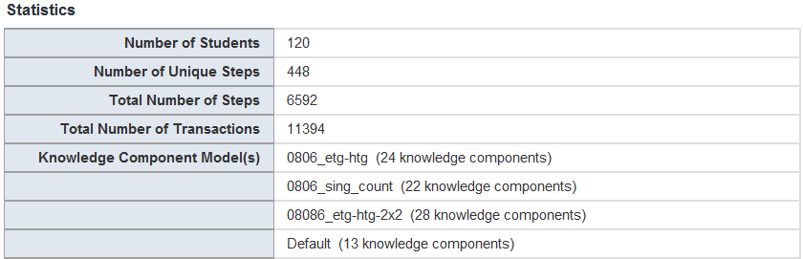
Dataset Info
Meta data for given dataset
PI’s get ‘edit’ privilege, others must request it
Papers and Files storage
Problem Breakdown table
Dataset Metrics
14
Notes:
Here is the Dataset Info page. Here you can select to view the dataset overview or and papers and files associated with the dataset. You must have edit access to upload, modify or remove files.
This screen depicts the overview page, which provides meta data (which is editable by the project PI) as well as some metrics like total # tx and KC models.
Below you’ll find the problem breakdown table, which breaks out each problem by dataset level, then problem name, then step name. This is exportable as well.

Slide 15
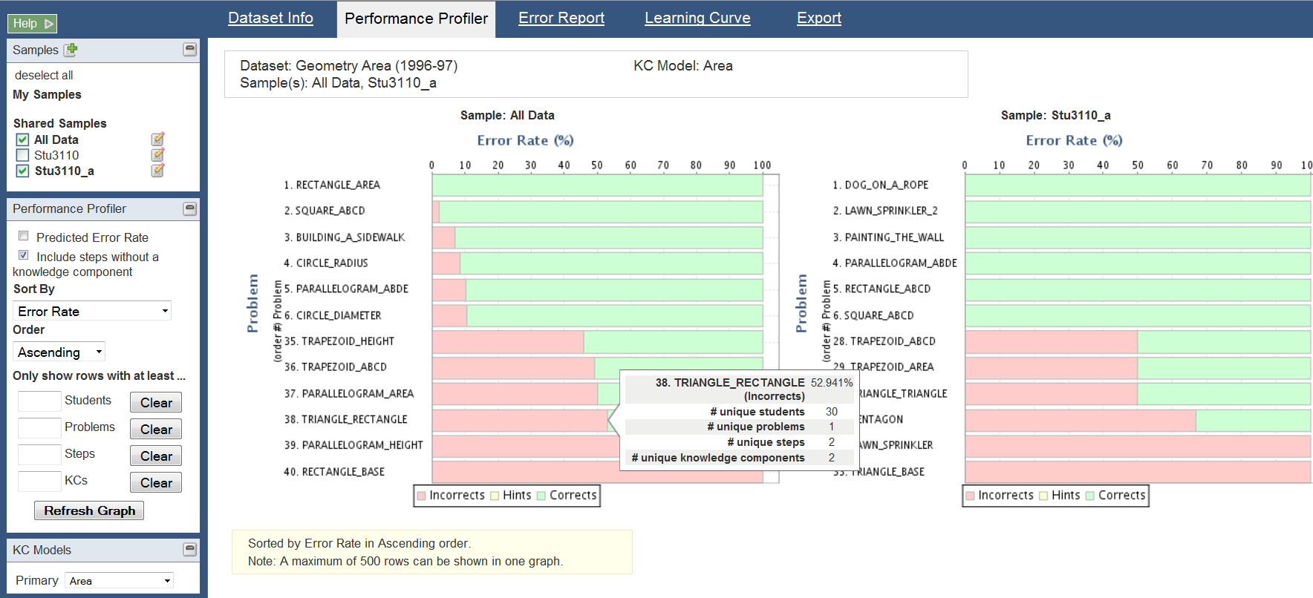
Performance Profiler
Multipurpose tool to help identify areas that are too hard or easy
View measures of
Error Rate
Assistance Score
Avg # Hints
Avg # Incorrect
Residual Error Rate
View multiple samples side by side
Aggregate by
Step
Problem
Student
KC
Dataset Level
Mouse over a row to reveal uniqueness
Notes:
Next is our newest and probably most underused tool – the PP.
Use this tool to drill down into student performance across different aggregations and measures of performance.
It’s all neatly presented in a bar graph for you. Here we are viewing the error rate across KCs, showing the 6 easiest and 10 hardest KCs, including hints. Mousing over an entry provides more details – such as the number of students, steps, and knowledge components.
The power of this tool is fuled by the flexibility offered. You can aggregate by step, problem, KC or dataset level while viewing a slew of performance measures. You can also use this tool if your dataset contains no KC models.

Slide 16
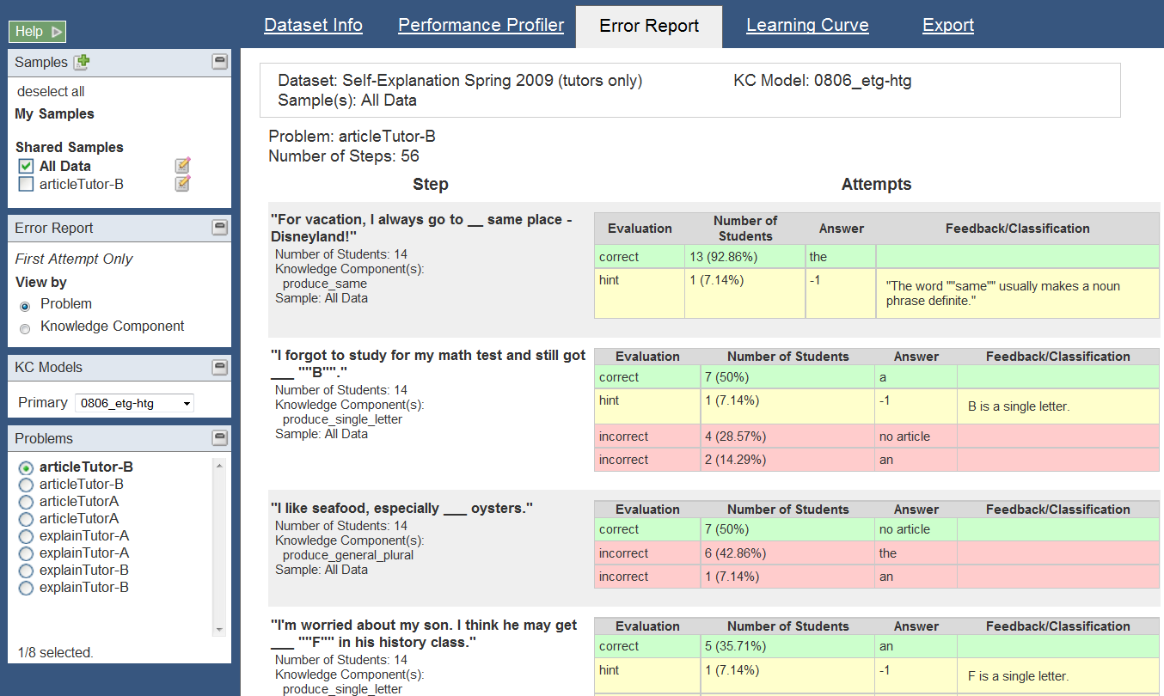
Error Report
Provides a breakdown of problem information (by step) for fine-grained analysis of problem-solving behavior
Attempts are categorized by evaluation
View by Problem or KC
Notes:
Up next, the Error Report.
This tool provides a breakdown of problem information by individual problem steps.
Here you can see the details of what the student actually typed.
Results displayed are for 1st attempt at a step. This report displays corrects, hints and errors, viewable by problem or KC

Slide 17
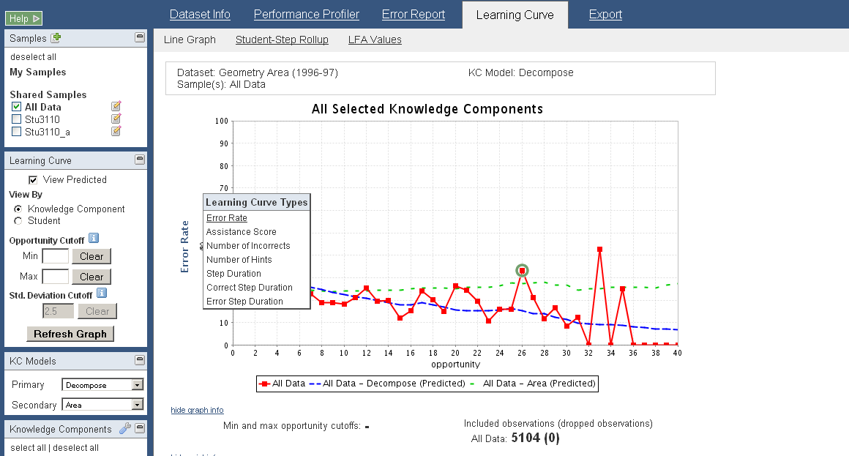
Learning Curves
Visualizes changes in student performance over time
Hover the y-axis to change the type of Learning Curve.
Types include:
Error Rate
Assistance Score
Number of Incorrects
Number of Hints
Step Duration
Correct Step Duration
Error Step Duration
Time is represented on the x-axis as ‘opportunity’, or the # of times a student (or students) had an opportunity to demonstrate a KC
Notes:
To select a curve type you simply hover the y-axis

Slide 18
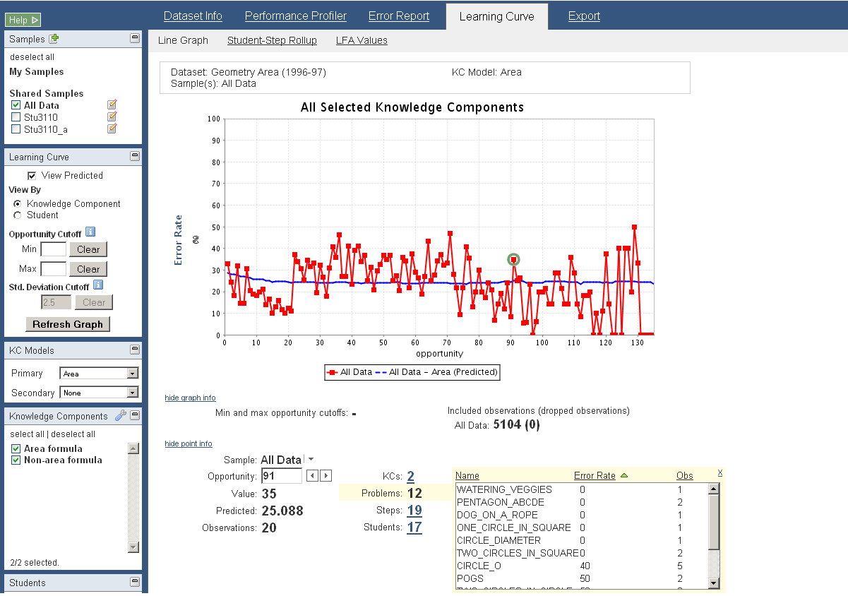
Learning Curves: Drill Down
Click on a data point to view point information
Click on the number link to view details of a particular drill down information.
Details include:
Name
Value
Number of Observations
Four types of information for a data point:
KCs
Problems
Steps
Students

Slide 19
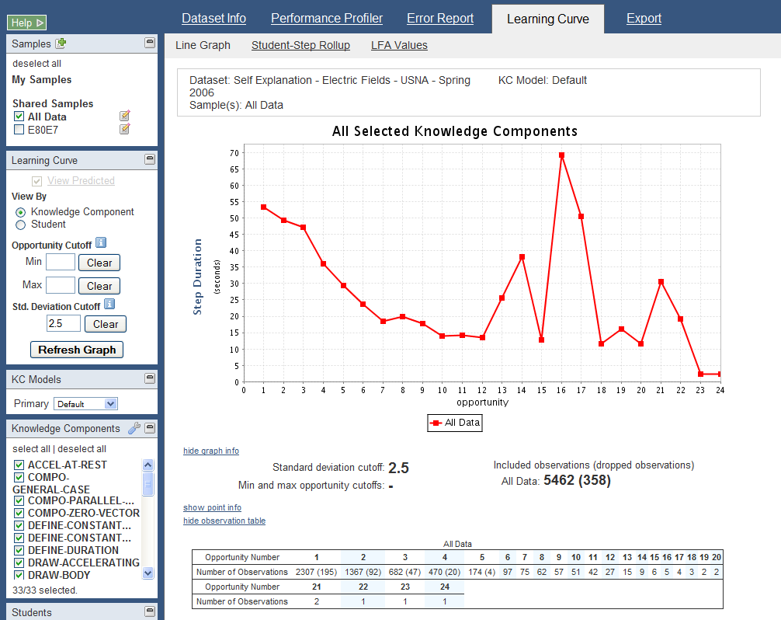
Learning Curve: Latency Curves
For latency curves, a standard deviation cutoff of 2.5 is applied by default.
The number of included and dropped observations due to the cutoff is shown in the observation table.
Step Duration = the total length of time spent on a step. It is calculated by adding all of the durations for transactions that were attributed to a given step.
Error Step Duration = step duration when first attempt is an error
Correct Step Duration = step duration when the first attempt is correct
Notes:
To customize your latency curve you can apply a standard deviation cutoff. Std deviation cutoff is useful in the context of latency curves for eliminating outliers that affect the graph.
On first load, DataShop applies a cutoff of 2.5 by default. To change that, simply enter the cutoff of your choice and click the refresh graph button.
You’ll notice the observation table now includes the number of dropped observations in parenthesis.
<ANY QUESTIONS??>

Slide 20
Learning Curve exercise

Slide 21
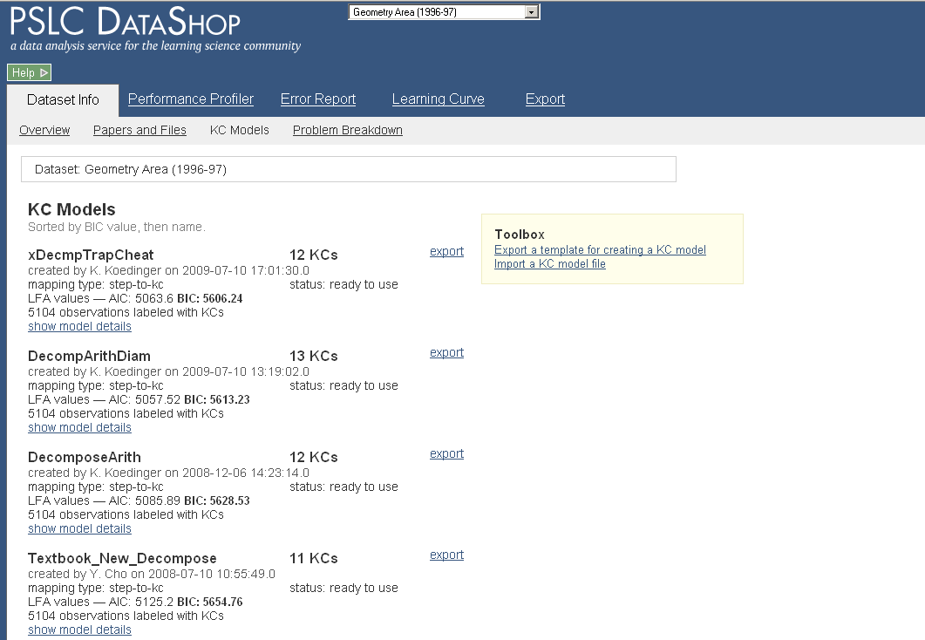
Dataset Info: KC Models
Toolbox allows you
to export one or more KC models, work with them, then reimport into the
Dataset.
Handy information displayed for each KC Model:
Name
# of KCs in the model
Created By
Mapping Type
AIC & BIC Values
DataShop generates two
KC models for free:
Single-KC
Unique-step
These provide upper and lower bounds for AIC/BIC.
Click to view
the list of KCs
for this model.

Slide 22
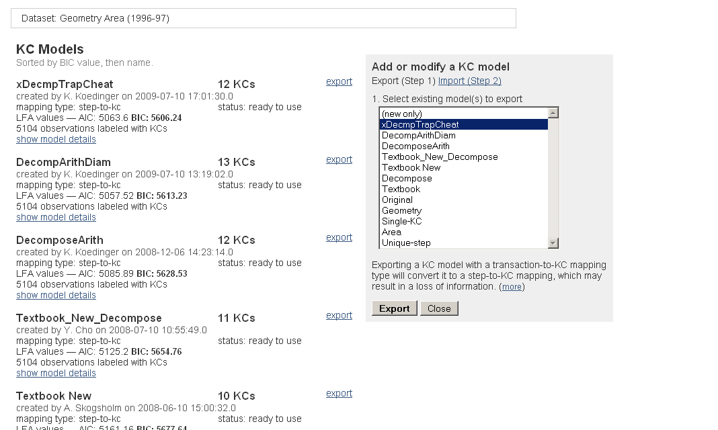
Dataset Info: Export a KC Model
Select the models you wish
to export and click the
“Export” button.
Model information as well as
other useful information is
provided in a tab-delimited
Text file.
Selecting the “export”
option next to a KC Model
will auto-select the model
for you in the export
toolbox.
Export multiple models at once.
Notes:
To select a model or models to export, you can either click on “export” next to the model’s name, or select them from the export toolbox.
The exported file will not only contain the models you have chosen to export, but will also have additional information that should make your kc modelling task easier. Finally, the exported file provides you data in a format that allows your to re-import the kc model (or a new model).
Note, you cannot import a tx_export, well you can try, but you will not be successful ☺
<should demo export a KC model here>
<go through the various columns to show what information is available to help with modeling task>

Slide 23
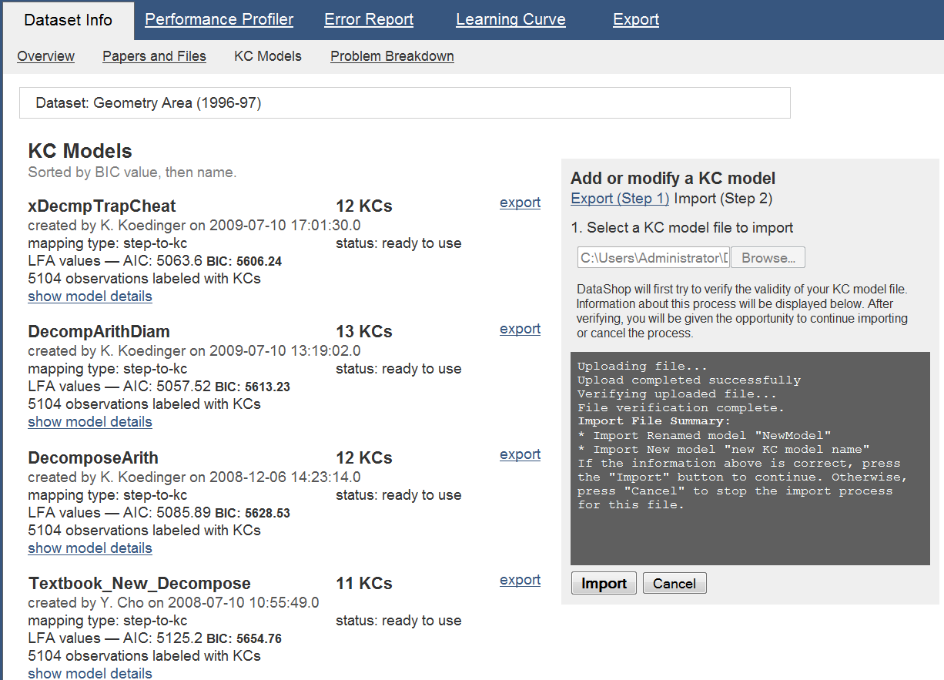
Dataset Info: Import a KC Model
When you are ready to import,
upload your file to DataShop for
verification.
Once verification is successful,
click the “Import” button.
Your new or updated model will
be available shortly (depending
on the size of the dataset).
Notes:
Once you are ready to test your new and or improved models, simply return to the KC model toolbox and select the “Import” option.
Here you will be able to chose your KC model file, upload it to the system and have it verified for correctness. If there are problems encountered during file verification the system will alert you, via the toolbox console.
If your file is perfect in every way, the “Import” button will become active. Clicking it will start the import process for your KCM file.
If you are overwriting an existing model that you own, you will be prompted to confirm this by the system. If you decide you don’t want to do this, you can rename the new model, or you can skip it.
If a model name in your import file matches an existing model within the dataset, but you do not own it, then you must rename the model or skip it.
<JUMP TO WEB APP>
Ken has graciously offered to provide an in depth KC import/export demonstration.

