Slide 1
PSLC DataShop
Web Services Demo
http://pslcdatashop.org
Slides current to DataShop version 4.1.8
Alida Skogsholm
  DataShop Manager and Developer
Notes:
Welcome and thank you for attending out tutorial. I’m Alida Skogsholm, the DataShop Manager and one of the developers.
Note: Slides current to DataShop version 4.1.8.

Slide 2
Overview
Why Web Services??
Get Web Services Download
Getting Credentials
Authentication & DatashopClient
What is an ID?
How to get a dataset ID
How to see some transaction data
Add a little Swing…
Web Services URL
Notes:
The example that I’m going to show you is in Java. If you have Java on your laptop, feel free to get the client and run it on your own. You’ll need help from one of us to gain access which I’ll go over in a little bit.

Slide 3
Why Web Services??
To access the data from a program
  New visualization
  Data mining
  or other application

Slide 4
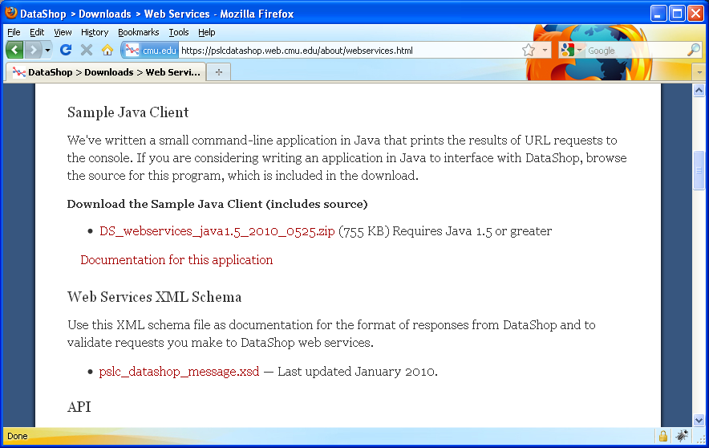
Get Web Services Download

Slide 5
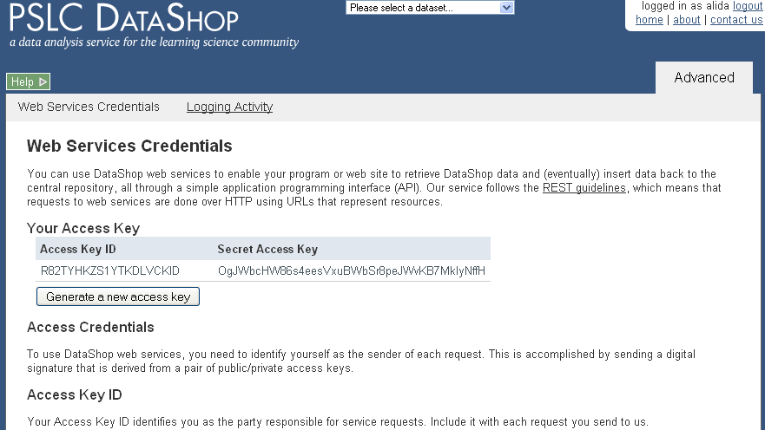
Getting Credentials

Slide 6
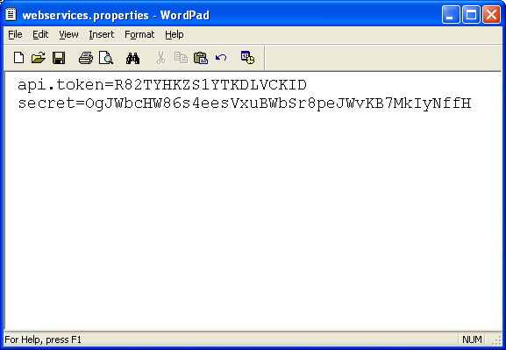
Authentication & DatashopClient
Put your token and secret access key in a file named ‘webservices.properties’

Slide 7
What is an ID?
The DataShop API expects you to reference various objects by “ID”, a unique identifier for each dataset, sample, custom field, or transaction in the repository.
The ID of any of these can be determined by performing a request to list the various items, which lists the IDs in the response.
For example, a request for datasets will list the ID of each dataset in the “id” attribute of each dataset element.

Slide 8
How to get a dataset ID
Use DatashopClient class provided in datashop-webservices.jar
Pass in a URL to form the request
Results include datasets that you have access to
java –jar dist/datashop-webservices.jar “https://pslcdatashop.web.cmu.edu/services/datasets”
<?xml version="1.0" encoding="UTF-8"?>
<pslc_datashop_message result_code="0" result_message="Success. 255 datasets found.">
<dataset id="145">
<name>Handwriting/Examples Dec 2006</name>
…
</dataset>
</pslc_datashop_message>

Slide 9
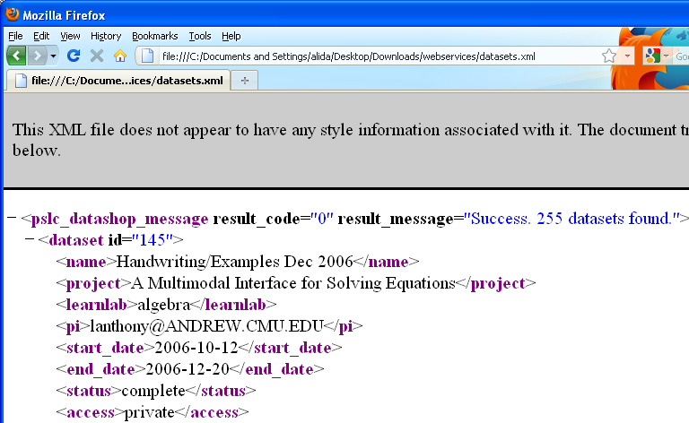
How to get a dataset ID
java –jar dist/datashop-webservices.jar “https://pslcdatashop.web.cmu.edu/services/datasets?access=edit” > datasets.xml
Notes:
You can redirect the results to a file and then open that file in a browser.
Then you can search on the dataset name you have in mind.
For this demo, let’s search on ‘Self-Explanation Spring 2009 (tutors only)’.

Slide 10
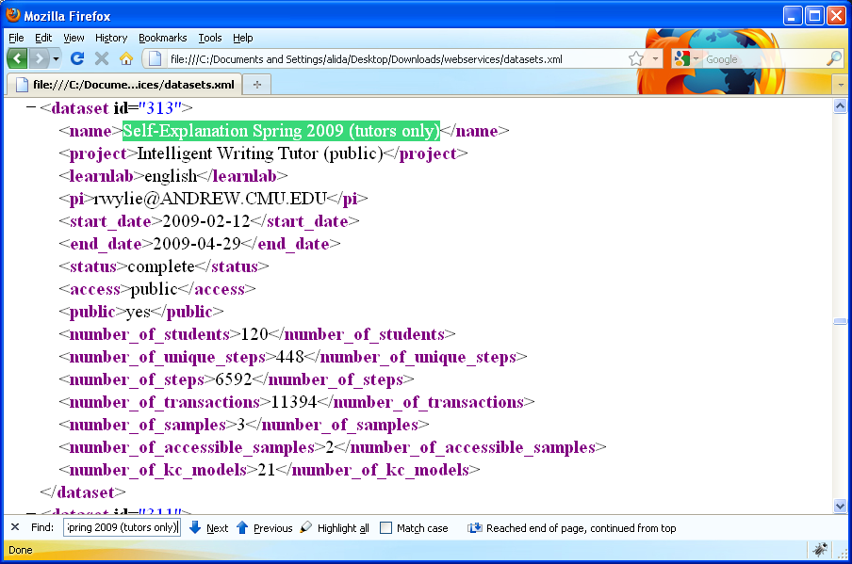
Open XML in browser and search
Notes:
There it is, and we see that it has the id of 74.

Slide 11
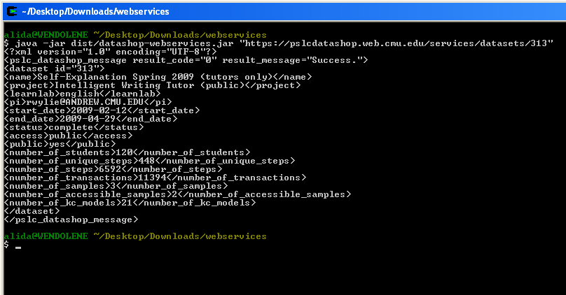
Back to command line

Slide 12
How to get a sample ID
java –jar dist/datashop-webservices.jar “https://pslcdatashop.web.cmu.edu/services/datasets/313/samples”
<?xml version="1.0" encoding="UTF-8"?>
<pslc_datashop_message result_code="0" result_message="Success. 2 samples found.">
<sample id="933">
<name>All Data</name>
<description>Default Sample that contains all transactions.</description>
<owner>%</owner>
<number_of_transactions>11394</number_of_transactions>
</sample>
<sample id="936">
<name>articleTutor-B</name>
<description>Default Sample that contains all transactions.</description>
<owner>liuliu@ANDREW.CMU.EDU</owner>
<number_of_transactions>2707</number_of_transactions>
</sample>
</pslc_datashop_message>
Notes:
To get a list of samples for the dataset we are interested in, we simply add to the previous request with the dataset and add the keyword ‘samples’ to the URL.
So now we see that the sample we created in DataShop, ‘Unit1’, has the sample id of 97.

Slide 13
How to see some transaction data
Request a subset of columns for a given dataset and the ‘All Data’ sample which is the default
java edu.cmu.pslc.datashop.webservices.DataShopClient “https://pslcdatashop.web.cmu.edu/services/datasets/313/transactions?
limit=10&cols=problem_hierarchy,problem_name,step_name,outcome,input”
Problem Hierarchy Problem Name Step Name Outcome Input
Unit IWT_S09articleTutorB-A, Section IWT Tests and Tutors articleTutor-B "The wo
Unit IWT_S09articleTutorB-A, Section IWT Tests and Tutors articleTutor-B "The wo
Unit IWT_S09articleTutorB-A, Section IWT Tests and Tutors articleTutor-B "The wo
Unit IWT_S09articleTutorB-A, Section IWT Tests and Tutors articleTutor-B "The wo
Unit IWT_S09articleTutorB-A, Section IWT Tests and Tutors articleTutor-B ___ oxy
Unit IWT_S09articleTutorB-A, Section IWT Tests and Tutors articleTutor-B ___ oxy
Unit IWT_S09articleTutorB-A, Section IWT Tests and Tutors articleTutor-B ___ oxy
Unit IWT_S09articleTutorB-A, Section IWT Tests and Tutors articleTutor-B ___ oxy
Unit IWT_S09articleTutorB-A, Section IWT Tests and Tutors articleTutor-B She too
Unit IWT_S09articleTutorB-A, Section IWT Tests and Tutors articleTutor-B ___ big
…

Slide 14
import edu.cmu.pslc.datashop.webservices.DatashopClient;
public class WebServicesDemoClient extends DatashopClient {
…
private static final String DATASETS_PATH = "/datasets/";
private static final String TXS_PATH = "/transactions?headers=false” + "&cols=problem_hierarchy,problem_name,step_name,outcome,input";
private WebServicesDemoClient(String root, String apiToken, String secret) {
super(root, apiToken, secret);
};
public TreeMap<TransactionDataSubset, Integer> runReport(String datasetId) {
String path = DATASETS_PATH + datasetId + TXS_PATH;
HttpURLConnection conn = serviceGetConnection(path);
conn.setRequestProperty("accept", "text/xml");
TreeMap<TransactionDataSubset, Integer> map = new TreeMap();
try {
InputStream is = conn.getInputStream();
BufferedReader reader = new BufferedReader(new InputStreamReader(is));
String row = null;
while ((row = reader.readLine()) != null) {
TransactionDataSubset t = TransactionDataSubset.createTransaction(row);
…

Slide 15
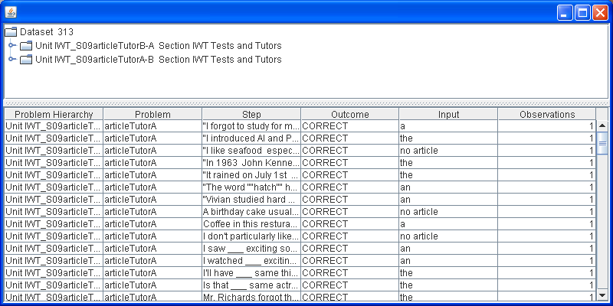
Add a little Swing…
java –classpath “../dist/datashop-webservices.jar;.” WebServicesDemoClientUI dataset 313

Slide 16
To get more details…
http://pslcdatashop.org/about/webservices.html
http://pslcdatashop.org/downloads/
WebServicesDemoClient_src.zip

